Slide 1

System Control, Data Acquisition & Smart Buildings
Presented by
David Bradley B.Eng (Hons), MBA, C.Eng, MIET, MCIBSE

Slide 2
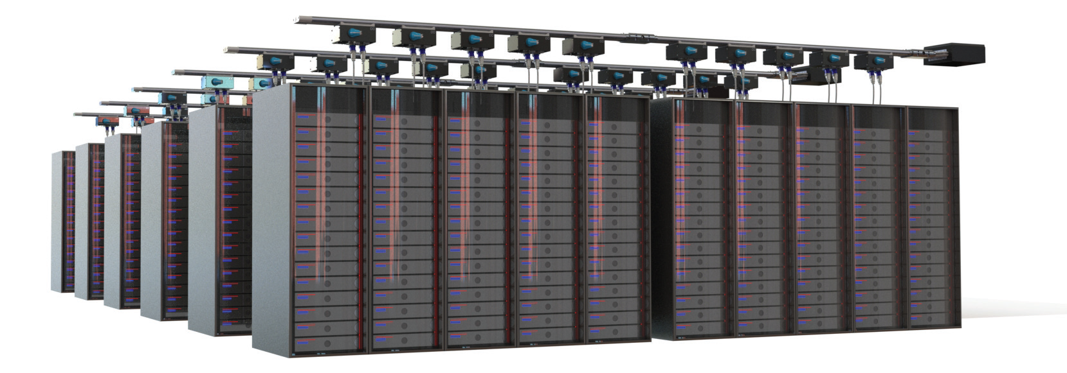
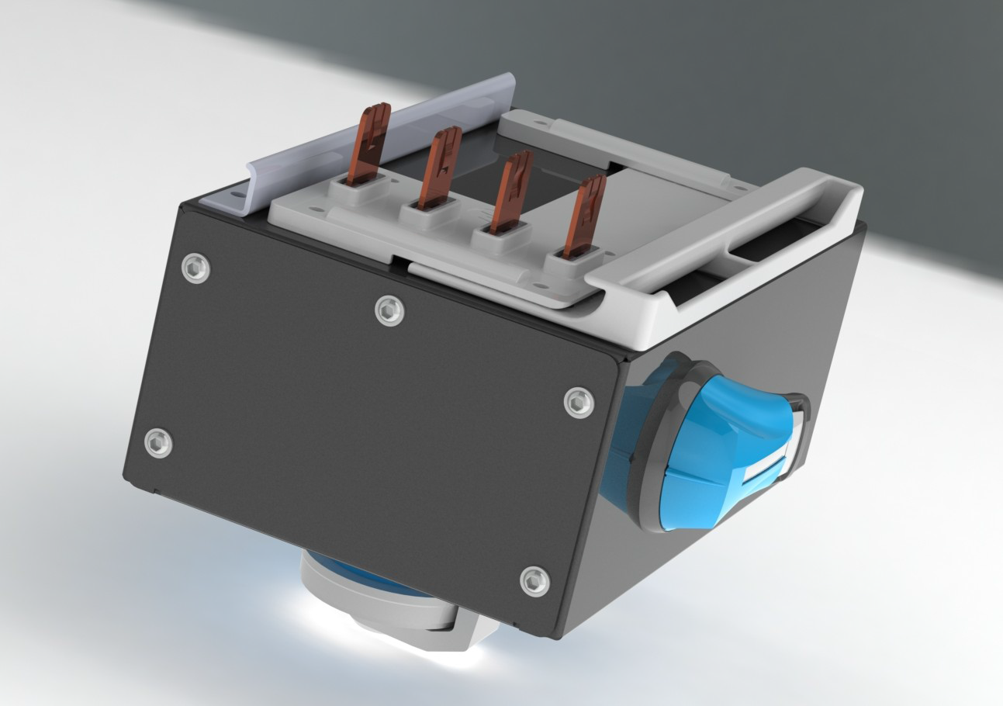
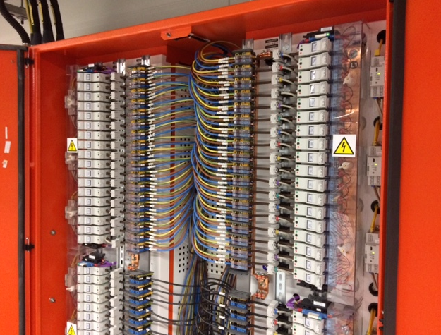
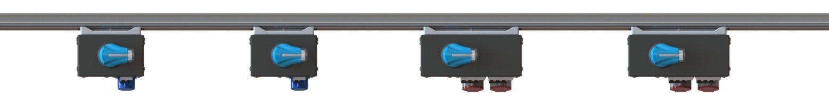
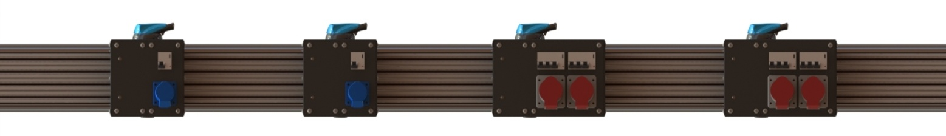
Critical Building Load
Notes:
Typical overhead installation

Slide 3

Power Distribution Units
Alternative to iMPB & Tap offs
Designed to Client specification
Deliver & monitor power within critical loads
Billing individual circuits
Active temperature monitoring
Optional Harmonic Filters

Slide 4
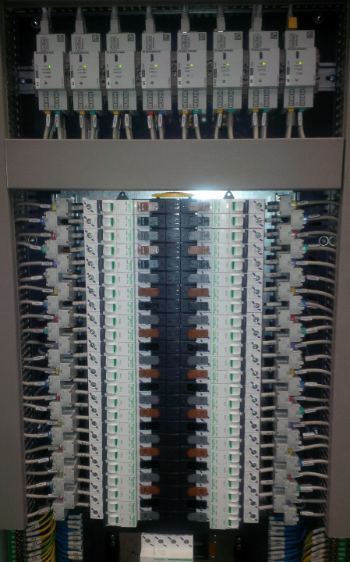
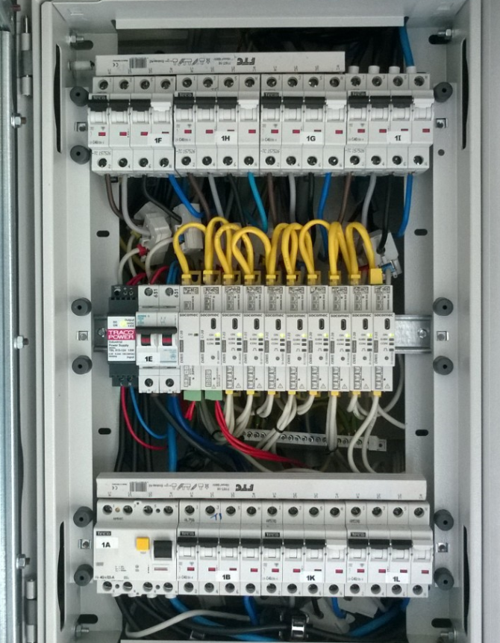
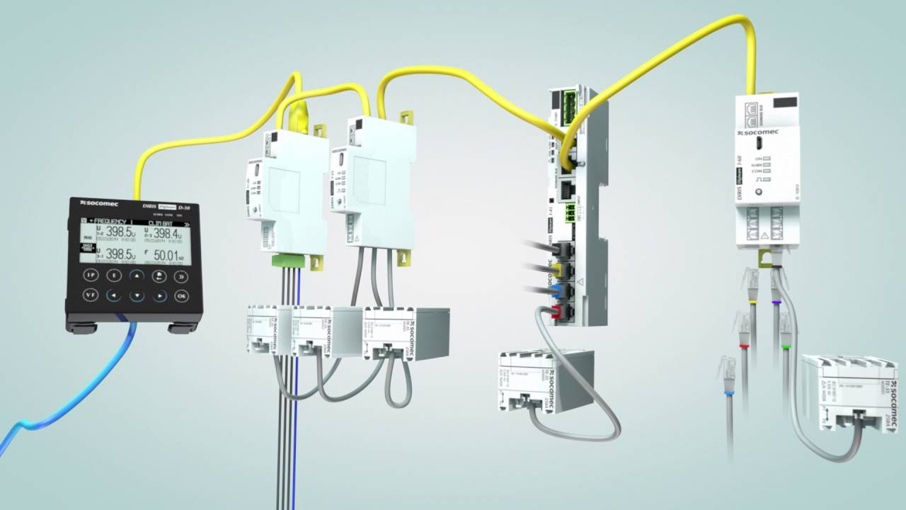

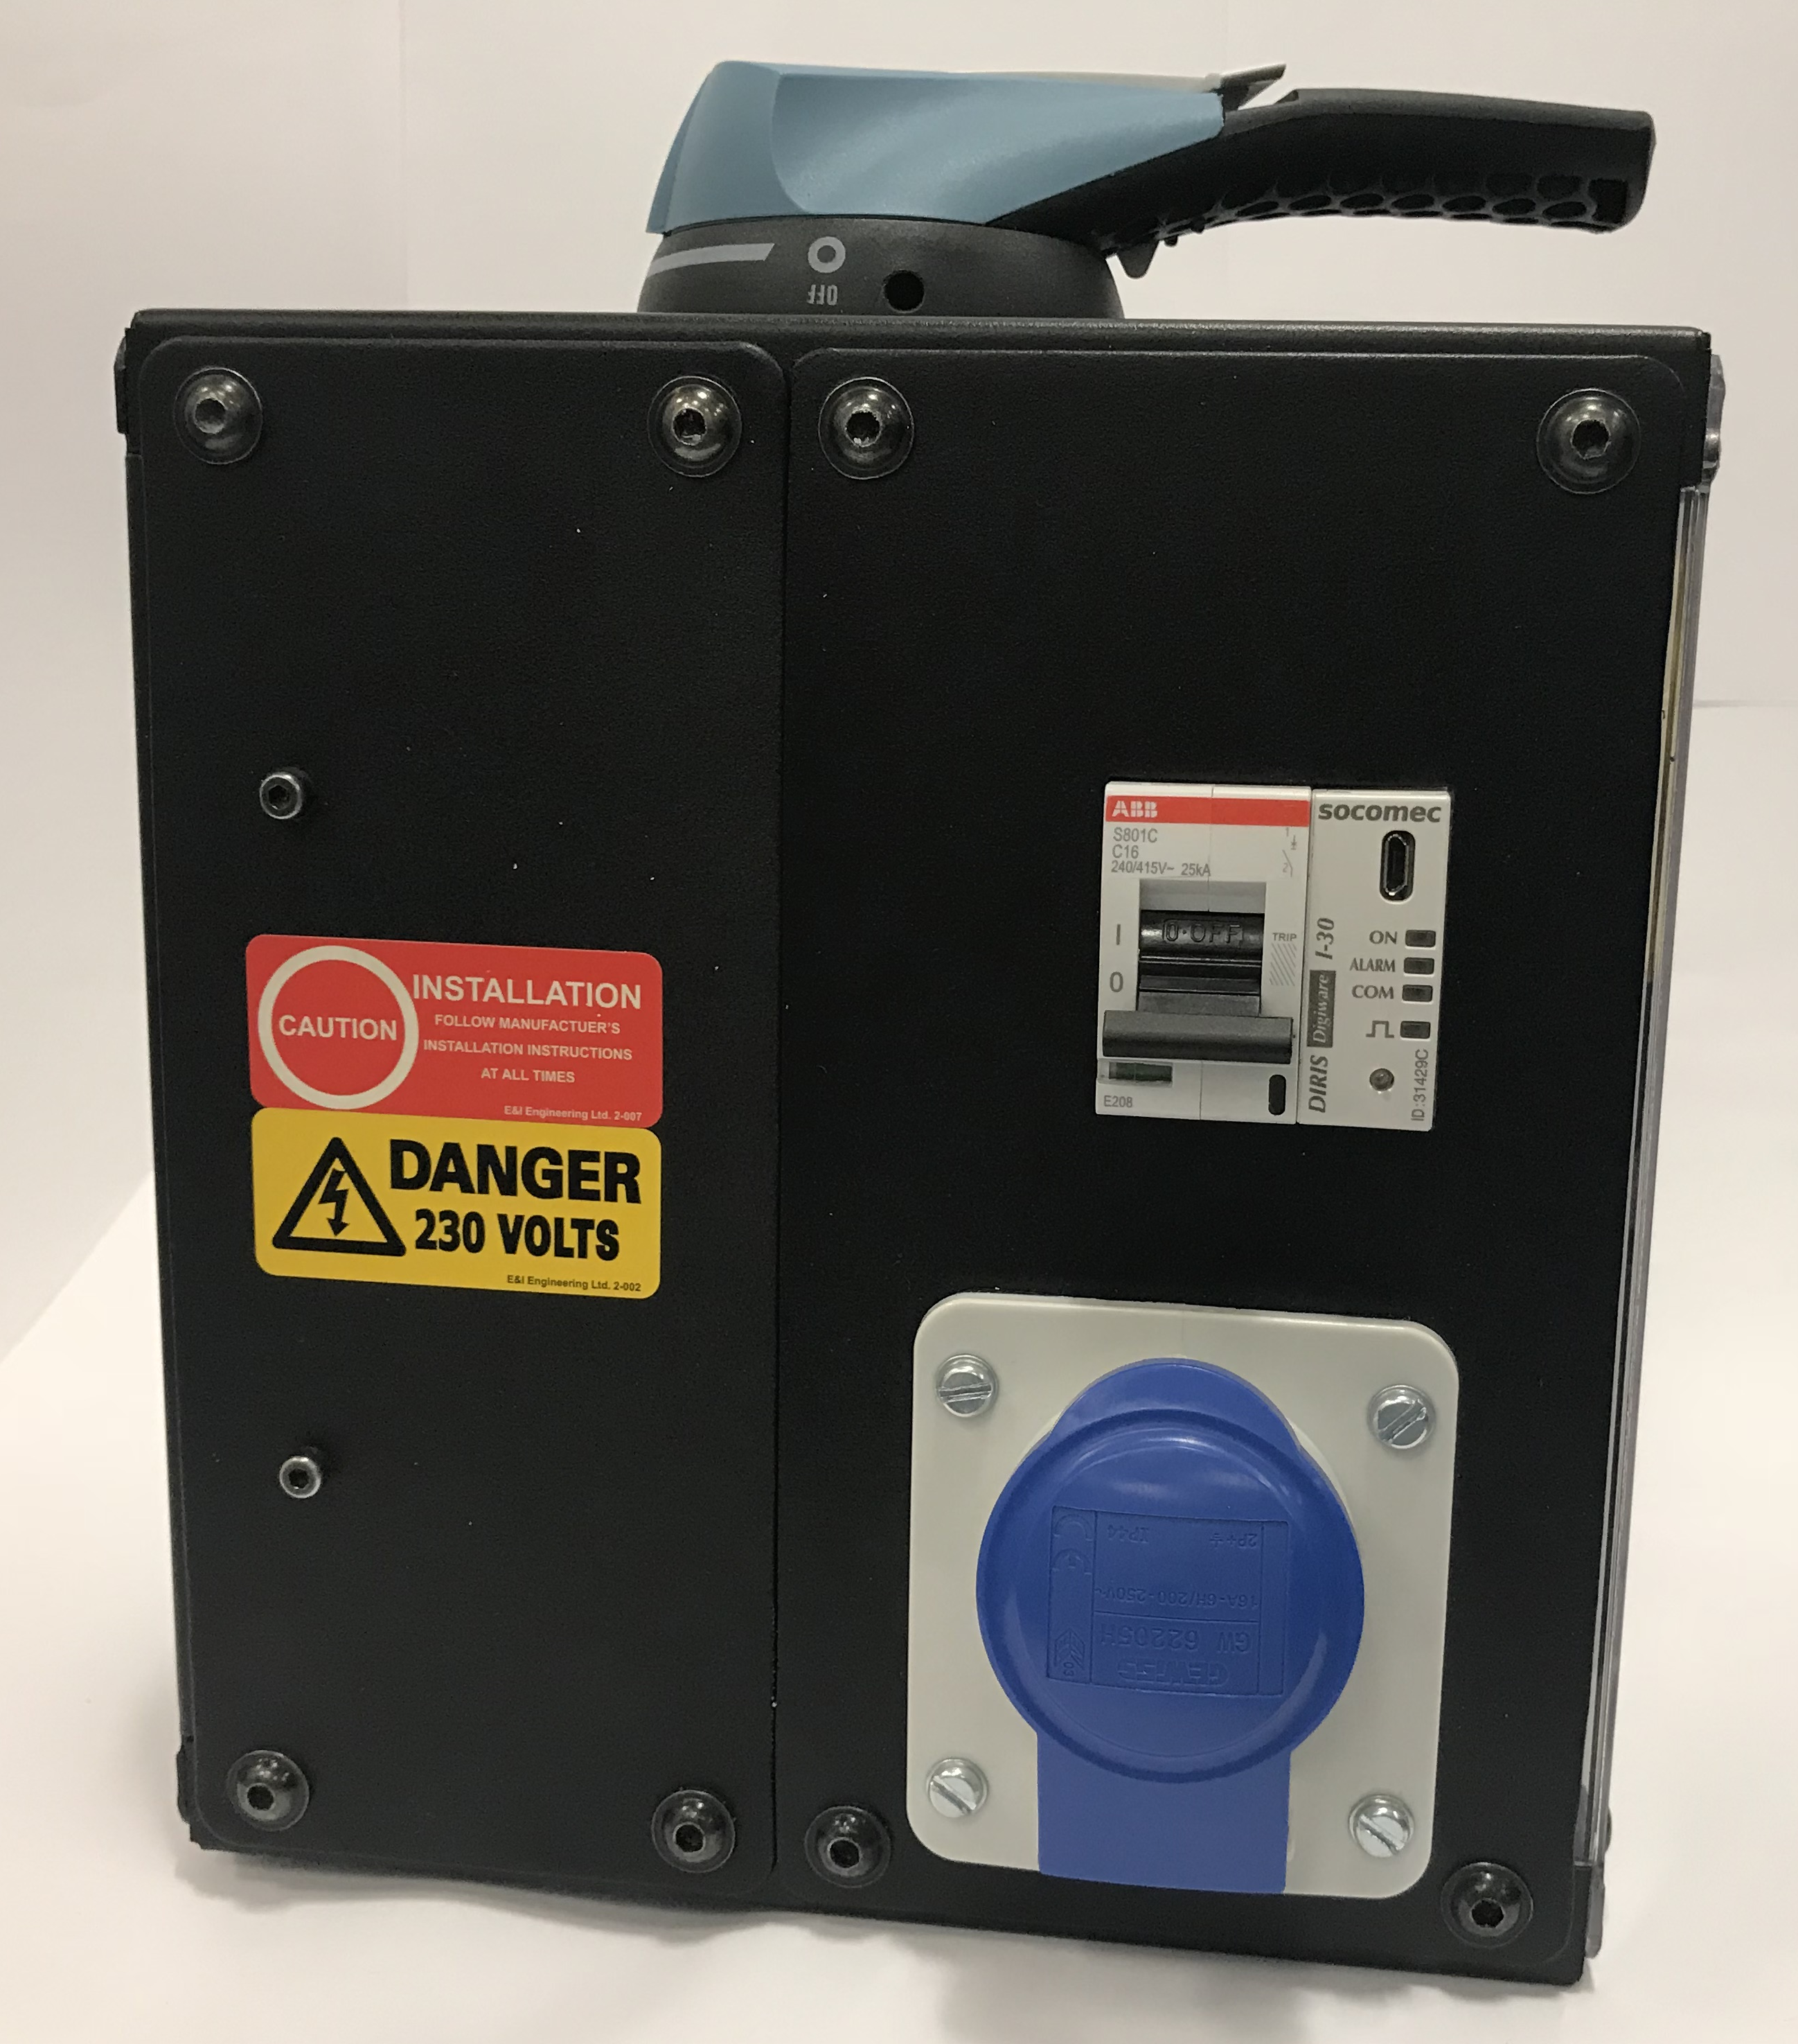
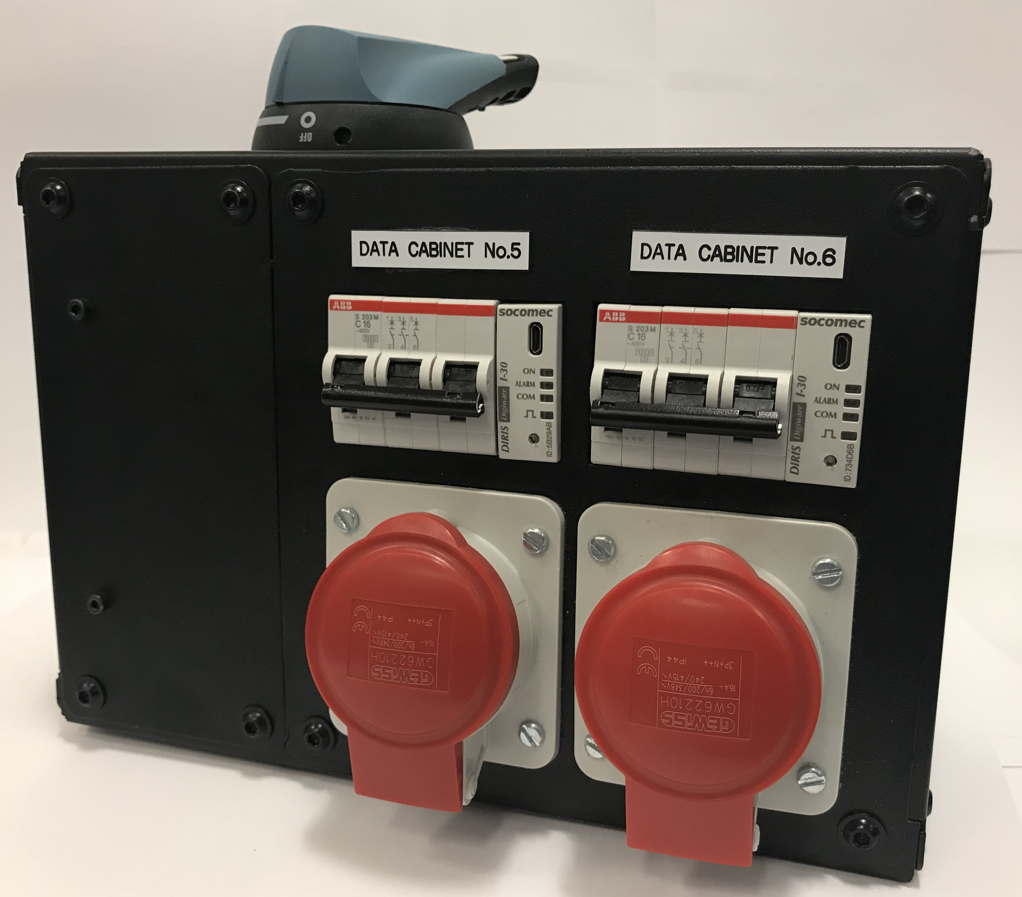
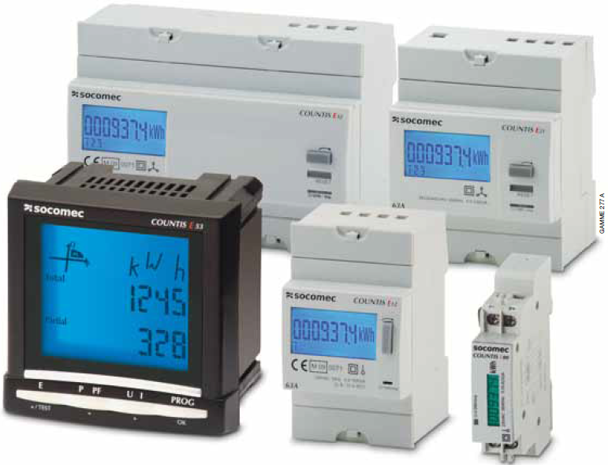
Tap Off & PDU Metering
Power management & Energy metering
U,I, P, Q, S, PF
Billing - MID
Energy consumption breakdown
Total Harmonic Distortion per load
Notes:
At sub-distribution (often located in risers) we will find MID approved meters for multi-tenanted buildings or more basic kWh meters.
At this level it is important to split the consumption between different uses (lighting, heating, IT, small power) to comply with part L

Slide 5
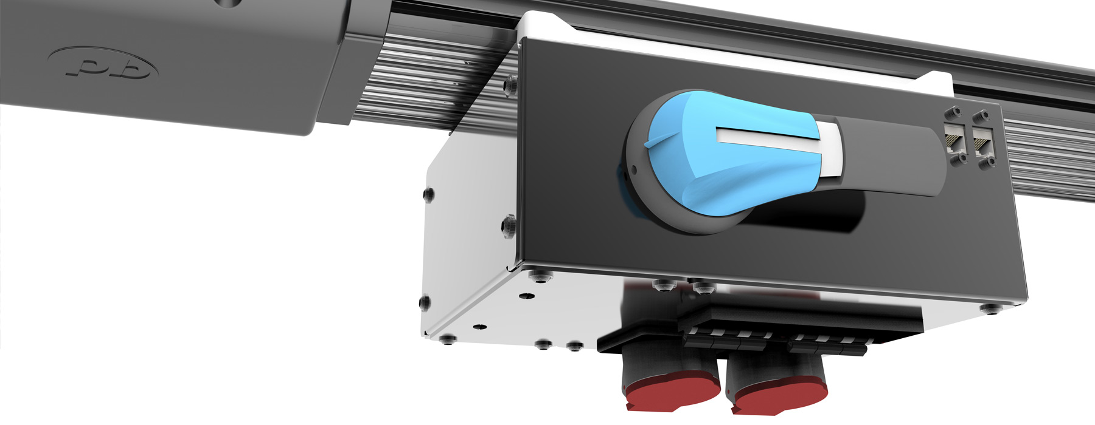

iMPB & Tap Offs vs Traditional PDUs
 | iMPB & Tap Off | Traditional PDU
Location | Locate exactly above the load | Central Location – Long cable runs
Live Working | Change Tap off Live Shutdown of PDU to change breakers
Circuits | Know exactly where the load is connected | Rely on labelling in PDU
Adaptability | Single phase or 3 Phase tap off can be installed and changed live to match load as and when | Forward design planning required for PDU
Space | No floor footprint – more space for racks | Floor space required in the whitespace
Metering/Billing | Optional Metering/Billing options in tap off can be installed as and when required | Potential shutdown required to install Metering/Billing if not installed day 1
Day 1 Costs | Minimal with no cabling and no crystal ball for the future (futureproofed) | PDU/Breaker and cabling costs day 1
Notes:
Advanced options:
- Voltage total harmonic distortion
- Overvoltage/ undervoltage alarm threshold
- Minimum and maximum current
- Demand and percentage load current
- Crest factor
- Warning and alarm threshold
It is also possible to monitor closed and trip status for each MCB. The status signals are fed back to the end feed using the integrated Ethernet cabling. The modules run in a daisy chain from meter to meter utilising the side channel in the housing for cabling. Push in side strips along the channel.
Plug and play technology – no additional cabling necessary
Protocols available: Modbus RTU, SNMP, TCP IP

Slide 6
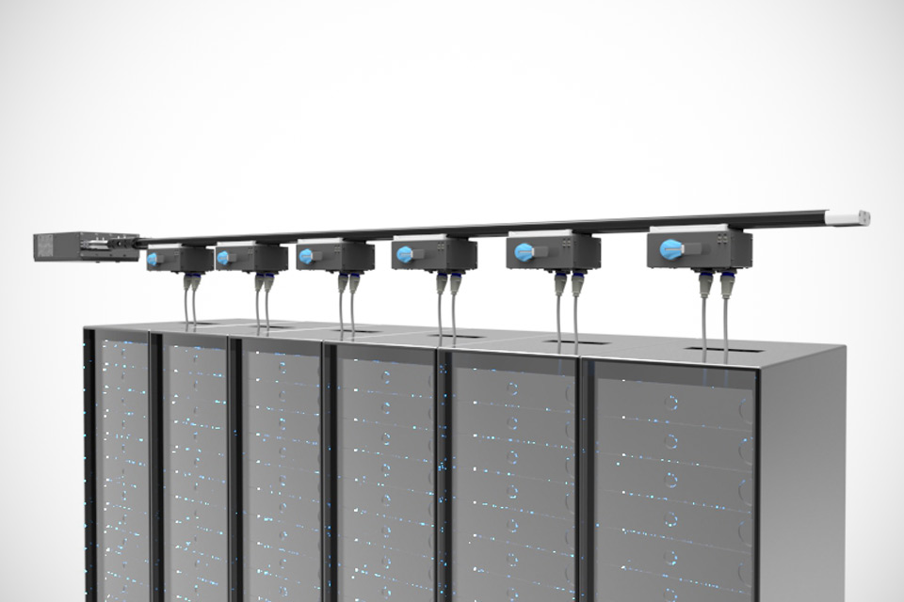
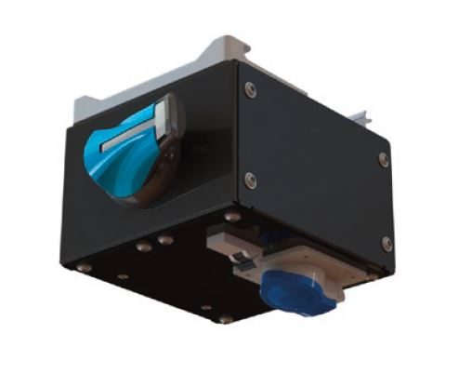
160A – 800A capacity
Oversized neutral (Triplen Harmonics) and 100% fully isolated ground
High density 99.99% conductivity copper
Aluminum housing acts as a ground path
kA rating (35kA/1 sec, 50kAIC, 77kA Peak)
All tap off boxes have a ‘ground first, break last’ safety feature
Individual tap-off boxes rated up to 125A
Same tap-off box is used for all ratings of busbar
Notes:
Highest kA – 25 kA RMS for 1 second for 160/250A – 50kAIC conditional
30kA RMS for 1 second for 400A – 50kAIC
Lengths available – 3/5/6/10/12/13’

Slide 7
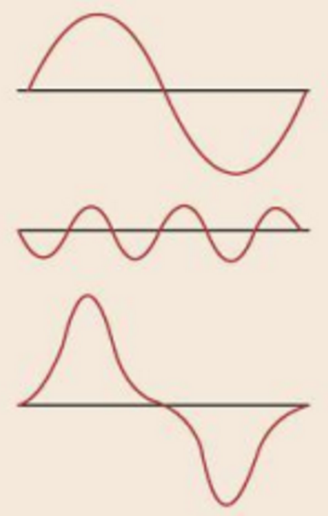
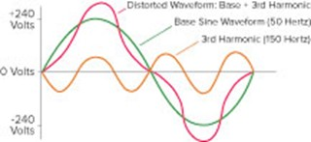
Waveform Distortion
Fundamental Pure Sinewave
PLUS
3rd Harmonic
EQUALS
Distorted Waveform
3rd Harmonic is third order of Fundamental Frequency i.e. 150 Hz (3x50Hz)

Slide 8
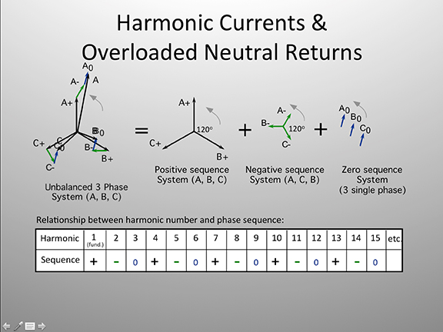
Positive, Negative &
Zero Sequence Harmonics
Notes:
Energy Networks Association Document G5/4 states the maximum permissible current for each harmonic.
How do we measure Harmonics?

Slide 9
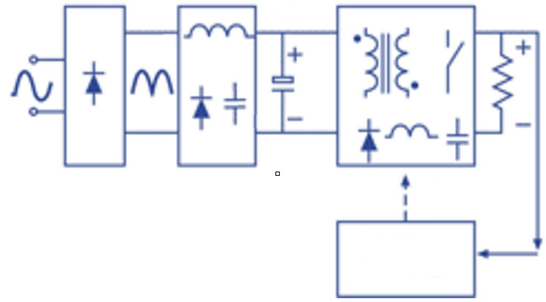
Solutions to compensate for Harmonics impact Power Factor
Rectifier
LC Filter
DC/DC output Stage
Typical input stage on a switch mode power supply. The LC filter will improve the THDI ‘seen’ by the source, improve the Power Factor and provide a ‘Leading Load’
Notes:
Switch mode power supplies have an input filter to improve the ‘load’ as presented to the supply.
The LC filter will improve THDI, improve the PF and provide a leading PF

Slide 10
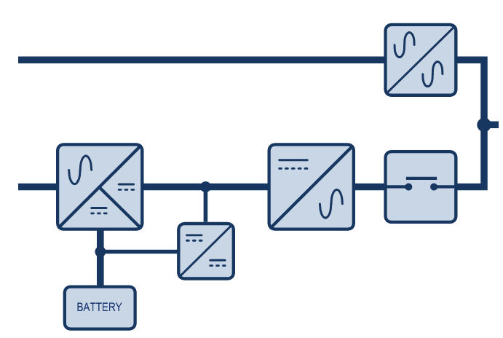
Backup Systems with UPS and Genset
Notes:
UPS systems are able to supply loads with a wide range of Power Factors

Slide 11
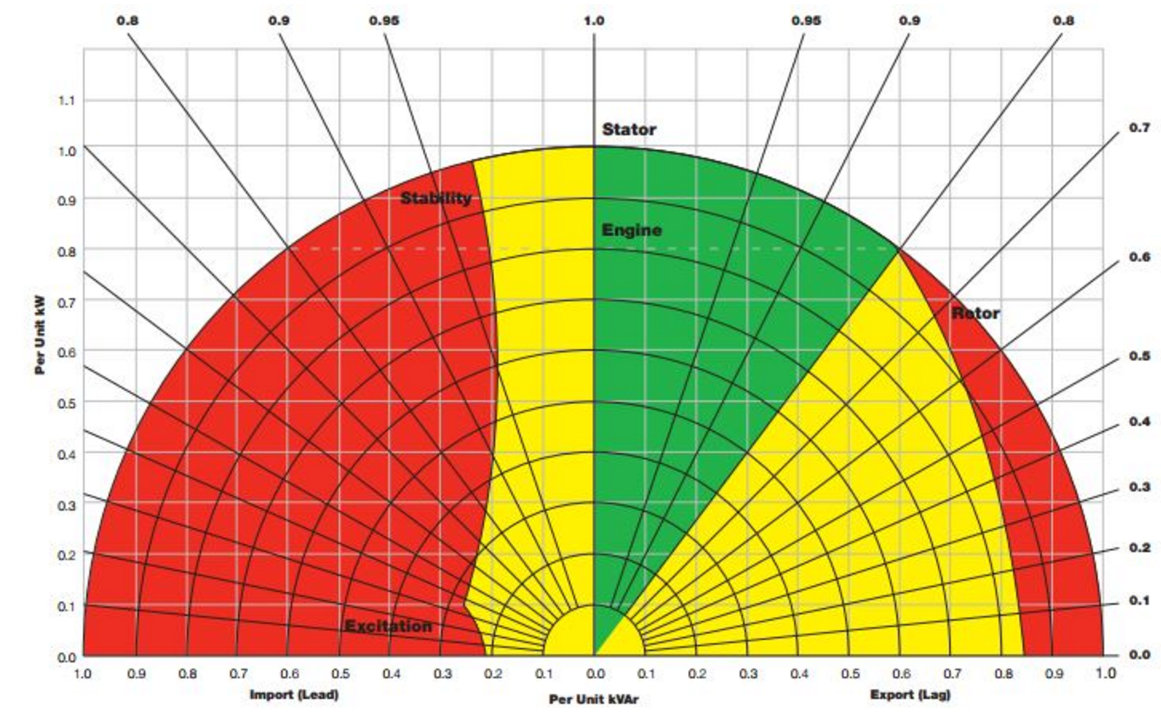
Backup Genset
Gensets are not able to supply loads with large Leading Power Factors
Notes:
Why is this important?
This curve (called circle diagram) gives the feature of a genset depending on the displacement power factor (DPF) of the load.
Displacement Power Factor contain the fundamental harmonic order only and True Power Factor take into consideration the entire spectrum of frequencies with all the harmonic orders.
The left side of the diagram concerns the leading loads. As soon as the PF is lower than 0.95, the derating of the genset is strong.
For PF = 0.9, the derating is around 40%.
Each genset has its own curve. This one is an example and you can find others with better or worse features.

Slide 12
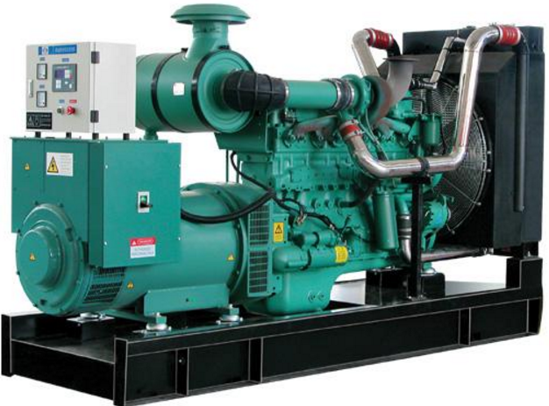
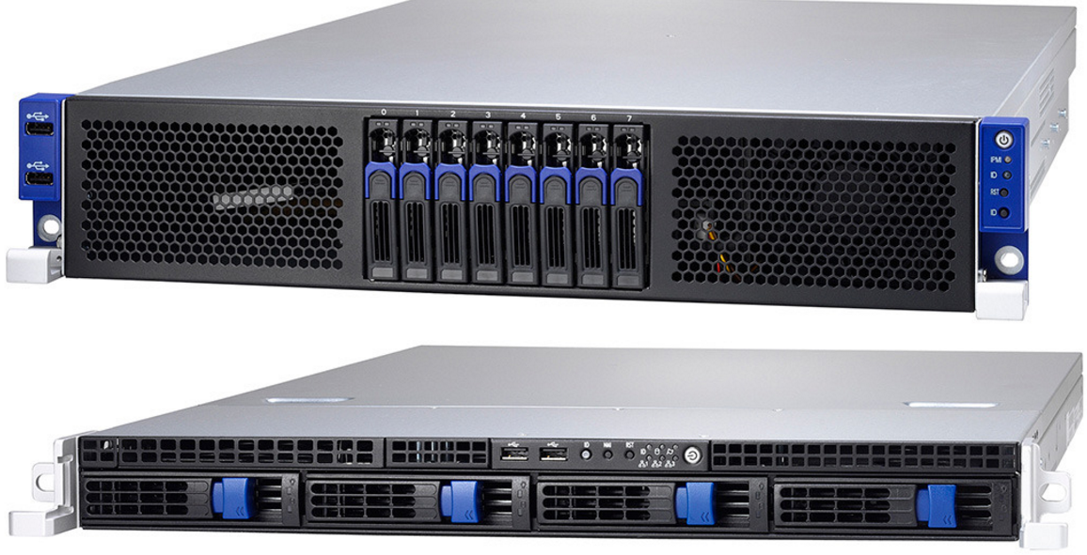
Importance of PF and
UPS/Genset operation
Genset Capacitive reactive power available:
115kVAR max
500kVA
Incompatibility between load and operation on backup Genset
Load Demand = 155kVAR
Option to account for PF and Genset Backup:
Oversize the Genset
Install Power Factor Correction (PFC)
320kW
cos ϕ = 0,9 Leading
Leading load
Notes:
In this example, a genset of 500kVA feeds a UPS of 400kVA.
Its capacitive reactive power is 115kVAR (given by the manufacturer).
Main features of the load :
PF = 0.9 leading
P = 320kW
THDI < 20%
⇒ Reactive power = 155kVAR capacitive
So, the genset can ’t feed the load. In a few cycles, it will stop due to an overvoltage detection causing a load loss.
What are the possible solutions ?
- To guarantee the compatibility between genset and load, the first solution consists in oversizing the genset by 35% ; what is most of the time impossible because of the cost.
- Another solution consists of using PFC to decrease the capacitive current seen by the genset. This active filter can compensate about 40kVAR which is enough to avoid the voltage trouble.

Slide 13

Skin Effect

Slide 14
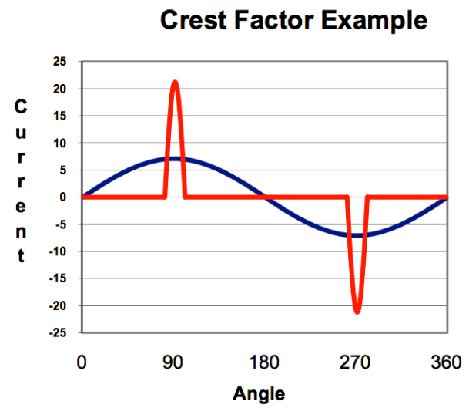
Crest Factor
Notes:
When sizing an AC power source it's important to understand the load being supplied not only the required rms current but also the Crest factor.

Slide 15

High Powerbar
Ingress Protection ratings of IP55 – IP68 available
1000V totally encased, non ventilated and low impedance busbar
Available in ratings from 800A – 6600A.
50 – 60Hz
kA rating (100kA/1 sec, 220kA Peak)
Type tested to 50°C ambient conditions
Available with a choice of 99.99% conductivity copper or 55% conductivity aluminium conductors to suit project specifications
Press Studs for Tap Offs (Not Welded)
No Mylar Wrapping needed between Conductors
Cast Resin Powerbar with IP68 available for outdoor solutions tested to 872°C for
3 hrs

Slide 16

Low Voltage Switchgear
LV Switchgear available from 800A – 6300A
Type tested to BS EN61439-1
ASTA certified heat rise performance and ASTA certified short circuit ratings available up to 100kA/1 sec.
All Forms of Separation available up to Form 4 Type 7
100% and 200% neutral busbar options
Seismically tested and certified

Slide 17

Medium Voltage Switchgear
Client specific solutions
Fault levels from 16kA – 40kA
Integration of internal arc prevention
Comprehensive interlocks
Incorporation of all major supplier protection relays
Vacuum and SF6 Solutions
Gas/air insulated busbar solutions
G59/G10 design to facilitate connection to the utility distribution network

Slide 18
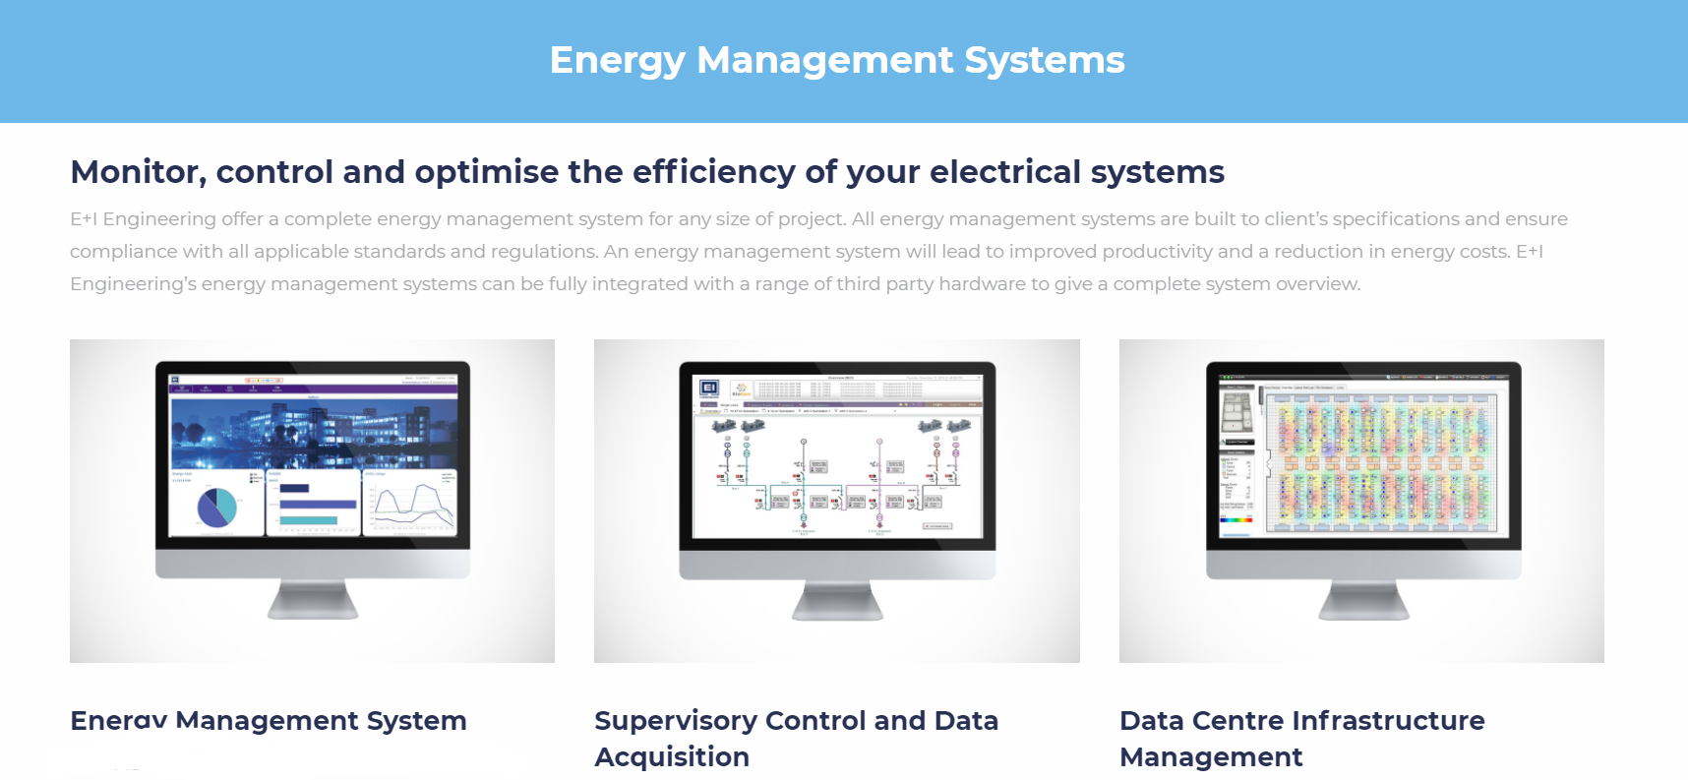
Energy Management Systems
Built to client’s specification
Total Supervision & Control
Reduce Energy Costs
Energy Management System
Supervisory Control and Data Acquisition
Data Centre Infrastructure Management

Slide 19

Critical Power EcoXpert Master Status
As an EcoXpert™ Master E+I Engineering staff have been trained and certified by Schneider Electric and have also demonstrated excellence through ongoing business accomplishments and professional development of staff.
EcoXpert ™ Critical Power Master companies have access to expert training on the latest range of Schneider Electric software which includes Power Monitoring Expert and Power SCADA.
This title recognizes E+I Engineering’s high level of electrical knowledge, including power measurement and power quality understanding.
E+I Engineering are one of just two companies in Europe, and twelve companies globally to be awarded this prestigious title.

Slide 20
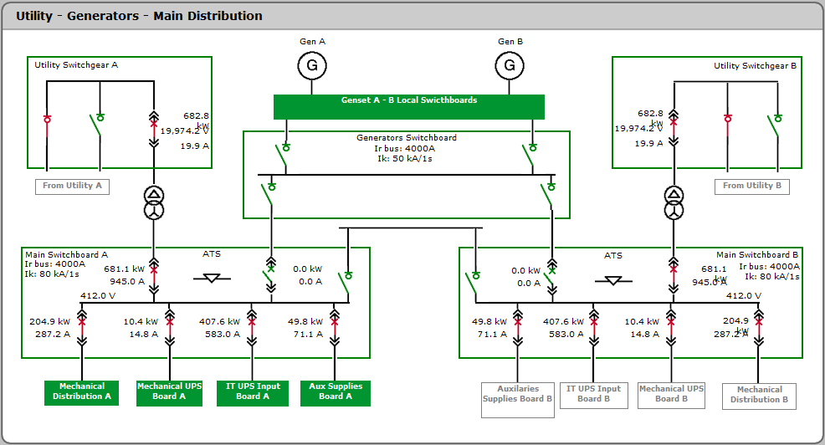
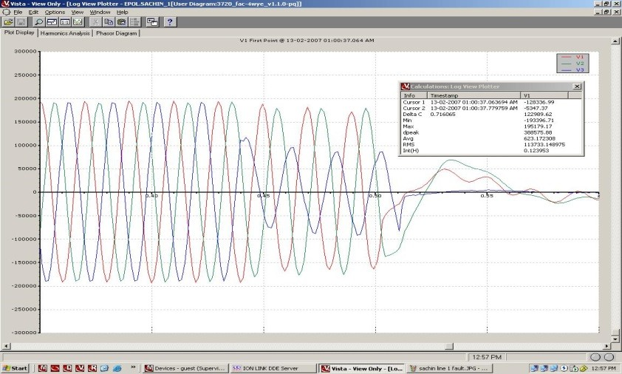

The Value of Root Cause Analysis
What is the impact of a complete or partial power outage at your facility—safety, restart time, increased down time etc.?
Troubleshoot specific events and find root cause that led to a power outage
Improve your power system reliability and operational effectiveness
Prevent catastrophic events from happening again or more importantly from happening at all!

Slide 21
Standard and Customised Reports
Manually, scheduled or event-driven
Automatically distributed (email, web, PDF, XML, HTML)
Standard reports within the EMS include:
  Aggregate energy and demand – multiple feeds, costs per tariff period, time-of-use
  Aggregate load profiles – system-wide usage patterns, peak usage
  IEC 61000-4-30 and EN50160 power quality compliance – pass/fail indicators
  Power Quality analysis – waveforms, tolerance curves, harmonics
  Multi-device energy usage
  Aggregated views of Energy usage by shift
  Tabular and Trend Views for any measurement
  Alarm history
  Summary report templates for WAGES reporting

Slide 22
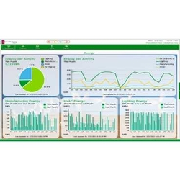
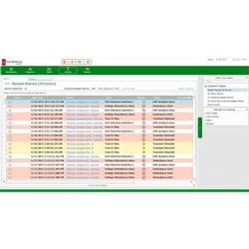
Alarms and Events
Quickly view active and unacknowledged alarms
Alarm banner provides system status from anywhere in the web application
Receive alerts to outages or impending problems
Trigger on PQ events, thresholds, equipment conditions, or complex/summary conditions
Meter alarms immediately pushed to system level
Automatically:
  Send customized notifications to workstations,
  email, mobiles, or PDA
  Upload all associated event data
  Generate a report
  Log complete information (coincident conditions, waveforms, timestamps)

Slide 23
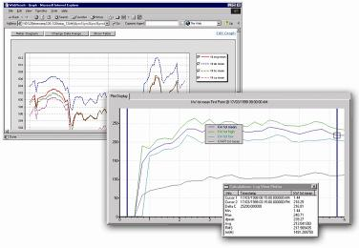
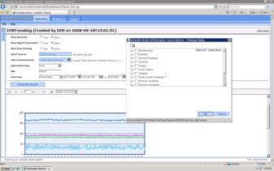
Trend Graphing and Aggregation
Single graph or multiple overlays for comparison
Trend any measured parameter:
  Voltage, current, power, power factor
  Demand, predicted demand, energy
  Harmonics
  Temperature
  Breakers Status
Graph aggregate load profiles
Create usage profiles
Track system-wide energy-related costs

Slide 24
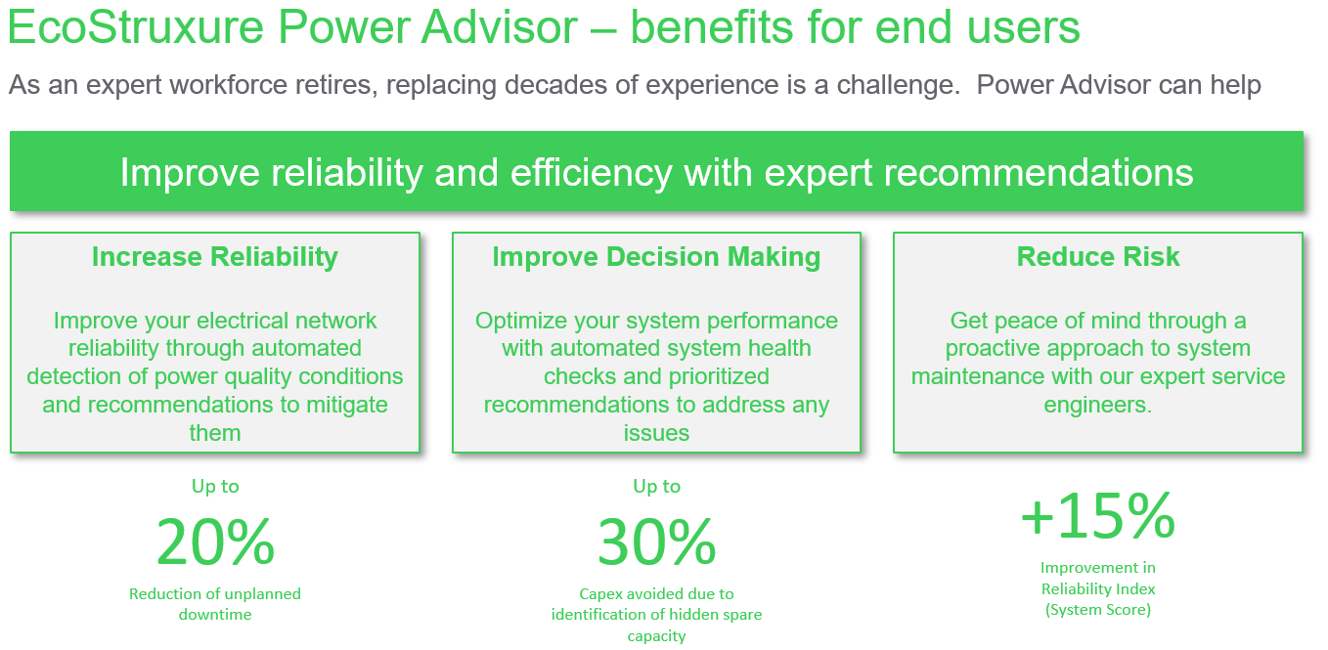
EcoStruxure™ Power Advisor
Full Metering Diagnostics
Identify Power Quality Issues

Slide 25
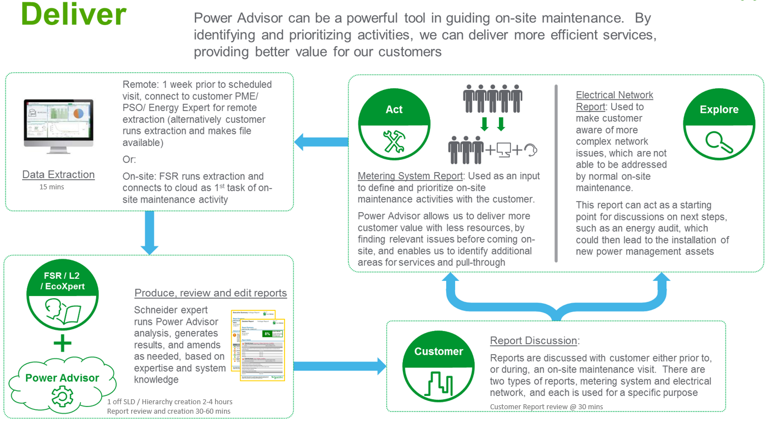

Slide 26
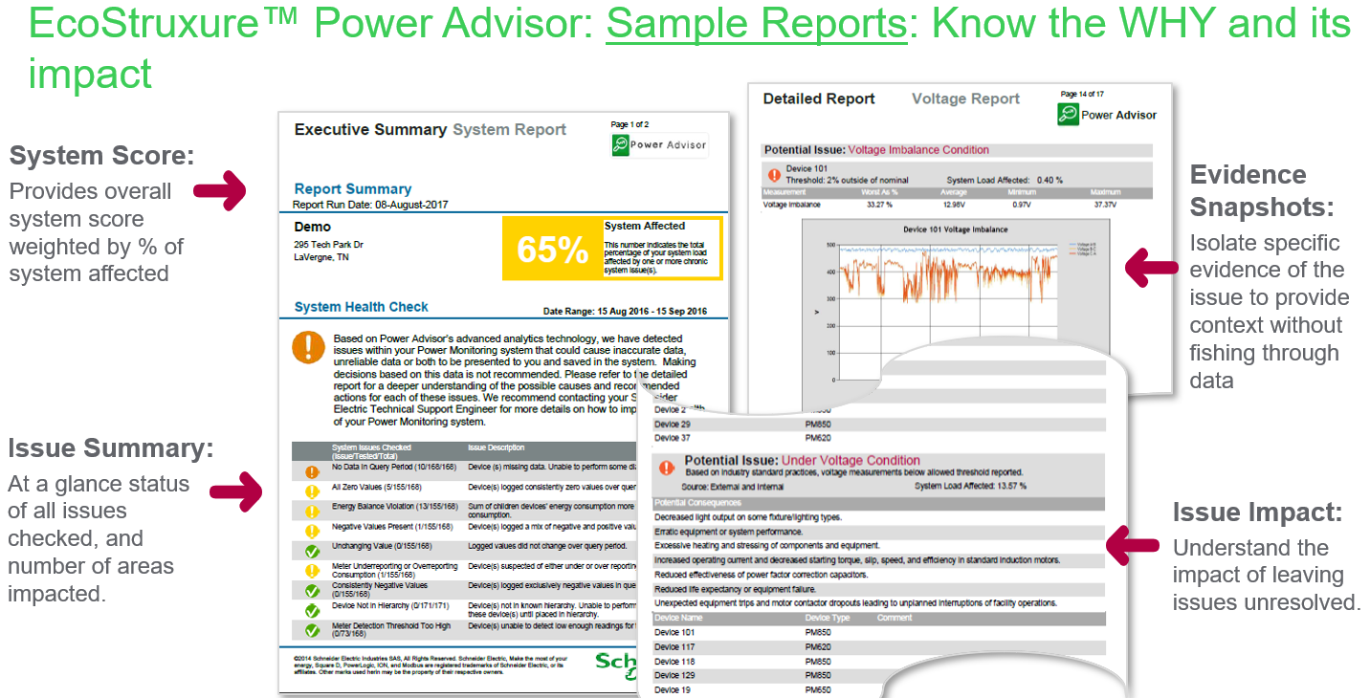

Slide 27
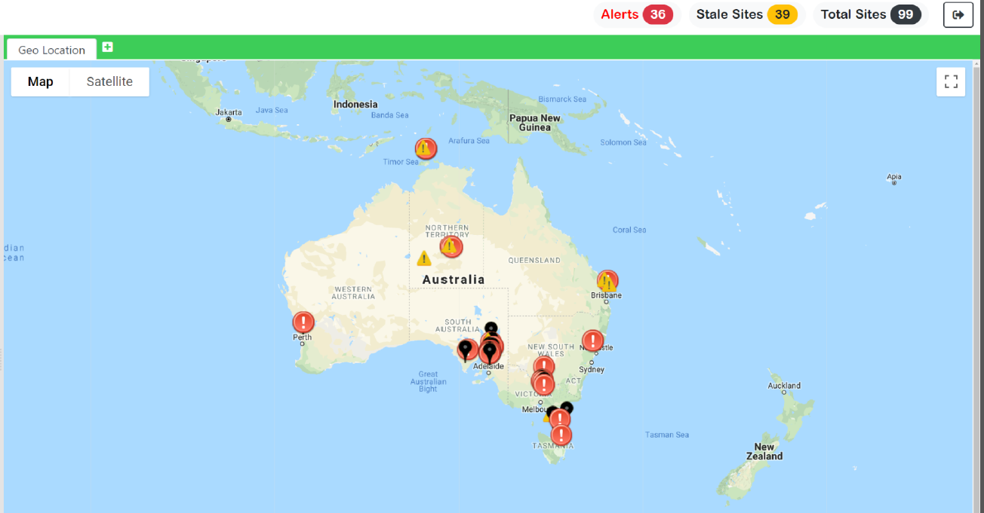
Mission Control
Automatically perform scheduled system diagnostics, dashboard a live map of multiple sites and their status, and email by exception.
Multi-Site System Monitoring
  “Mission Control” style monitoring of site and device status for single or multiple sites
  Dynamic map with interactive drill down diagnostic information available at a click
System Diagnostic Report
  Scheduled or on demand system checks; including Windows Services (ION and SQL), Communications, Tree States, “Last Log”, and Site Status
  Notify by email on exception when issues regarding data logging or device communication are detected;
  Feeds diagnostic information to the multi-site system monitoring system.
System Source Measurement Report
  Provides detailed source/measurement information including all sources and their corresponding measurements in the database, their source and measurement IDs, the valid time-range containing valid data, and the logging interval
  Filter by sources and measurements

Slide 29
Mission Control - 24/7 Monitoring
Utilizing the Mission Control software we can offer EMS infrastructure and application wide monitoring 24/7/365, with intelligent alert routing, resolution and reporting.
Monitor and track recurrent problems, looking to identify better ways to manage your infrastructure. This enables us to detect and resolve potential problems and reduce management load.
The rapid diagnosis of issues via remote support is critical to efficient infrastructure management. Guided by our customer support process, our help desk and engineering teams deliver expert support under agreed response times.
From our operations centre we remotely monitor and proactively identify potential system failures before disruptions to critical operations occur. Our engineers can diagnose and resolve critical EMS, SCADA or Server problems before they occur – 24x7x365.

Slide 30
PSO and PME Software Assurance
The cyber threat landscape is continuously evolving, and Schneider Electric includes cyber security
improvements in each release of their software packages. Customers concerned about cyber security should plan to upgrade to the latest software or firmware versions as they are made available. Promptly applying updates that include security improvements is the number-one thing you can do to help protect your system.
Power SCADA Operation (PSO) 9.0 and Power Monitoring Expert (PME) 9.0 is now available and it was designed to comply with cybersecurity standard IEC62443 at the component level (IEC62443-4-1 and IEC62443-4-2 SL1). This compliance includes major IT and security updates, including but not limited to:
Integration with Windows Active Directory for user authentication
Full removal of Silverlight plugin requirement for Web applications
SQL server Windows authentication mode
SSL enabled by default
Auto logoff timer and audit logs

Slide 31
Software Assurance Plan
Continuous improvements are being made to Power SCADA Operations and Power Monitoring Expert, obtaining a Software Assurance plan will enable you to take advantage of subsequent cyber security improvements in each release.
Reasons to utilise annual upgrade plan:
Cybersecurity – stay at the forefront of cybersecurity, ensuring your system is best protected from all current and future external threats.
Software Support – consistent software upgrade deferrals are a common theme across many industries. By not following annual upgrade plans, users can easily find themselves in time using a system no longer supported by the manufacturer. Depending on the nature of a critical system failure, manufacturer support can be the difference in timely resolution of faults and extended periods of system downtime.
Decrease Labour Intensity – by following an annual upgrade plan, the labour time required will be minimised, as will the potential for any downtime. With each annual upgrade missed, each iteration of the software must be systematically applied to the onsite EMS sequentially. This results in a much more laborious process and increased associated upgrade costs.

Slide 32
Modular Pre-Fabrication
The Way Forward

Slide 33
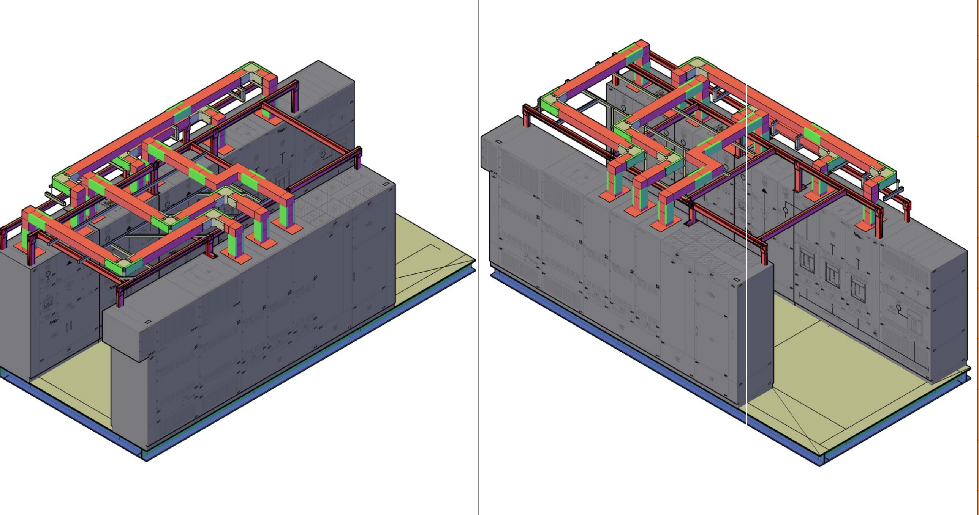
Power Skids –
Complete Power Unit with Integrated Monitoring & Control
All Monitoring & Control interfaces are pre-wired to a single hub within the skid.
Arrives on site fully inter-wired, commissioned and ready to hook up
On-site Monitoring & Control cabling is reduced to a single fibre connection.

Slide 34
Prefabricated Cladded Enclosures –
Complete Power Unit with Integrated Monitoring & Control
Usually insulated cladding is used to match a cladded building
Sometimes roof mounted as they are lighter than steel
Fire rated cladding with up to 2 hours protection

Slide 35
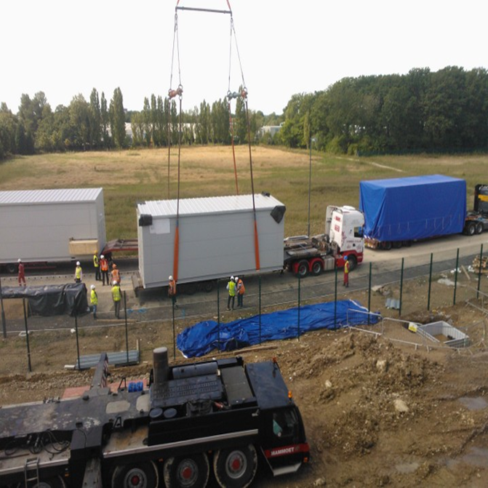
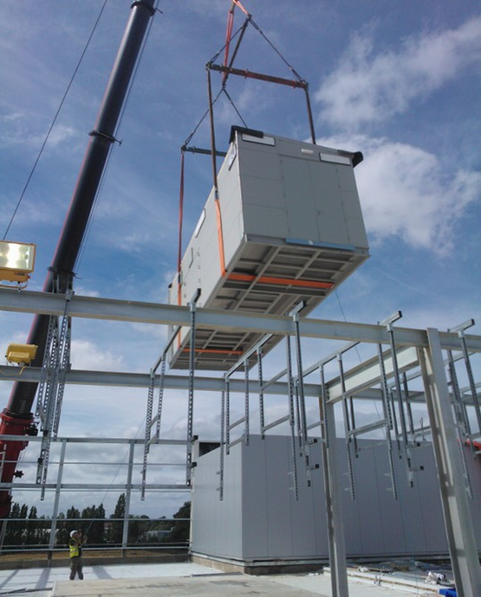
REDUCED LEAD TIME
INSTALLATION ON SITE
 | Conventional Installation | Modular Installation
Crane operation | 6 hours for 9 lifting operations – individual sections | 2 hours for 2 lifting operations – skid + transformer enclosure
 | 77% less lifting with modular approach
Switchgear installation | 5 operatives x 4 days of 11 hours = 220 man hours | 4 operative x 1 day of 11 hours = 44 man hours
Busbar links installation | 4 operatives x 4 days of 11 hours = 176 man hours | 0 man hours – completed in factory
Transformer enclosure installation |  | 4 operatives x 1 day of 11 hours = 44 man hours
Site testing of completed installation | 2 test engineers x 3 days of 11 hours = 66 man hours | 0 man hours – pre-tested in factory
Monitoring & Control site testing | 2 PMS engineers x 2 days of 11 hours = 44 man hours | 0 man hours – pre-tested in factory
Total per 2.5 MW skid | 424 man hours | 90 man hours
Total for 18 skid, 45MW project | 7,632 man hours | 1,620 man hours
Small text style

Slide 36
Thank you
David Bradley
dbradley@e-i-eng.com
Mob 07827 552920

