Slide 1

Balancing Performance With Building & Occupant Health
CIBSE Measuring performance & facilities Management – session 2
Peter Brown, Director Building Performance & Optimisation

Slide 2
Savills BP&O
Optimisation
Net Zero
Heat Networks
Air Conditioning Inspections (TM44)
Water Audits
Energy Performance Certificates (EPC+)
GENERAL
Metering
introduction
Energy Audits
ENERGY CONSULTANCY
BMS / BACS
Building Performance & Optimisation
ESOS & SECR
SECR
NABERS

Slide 3
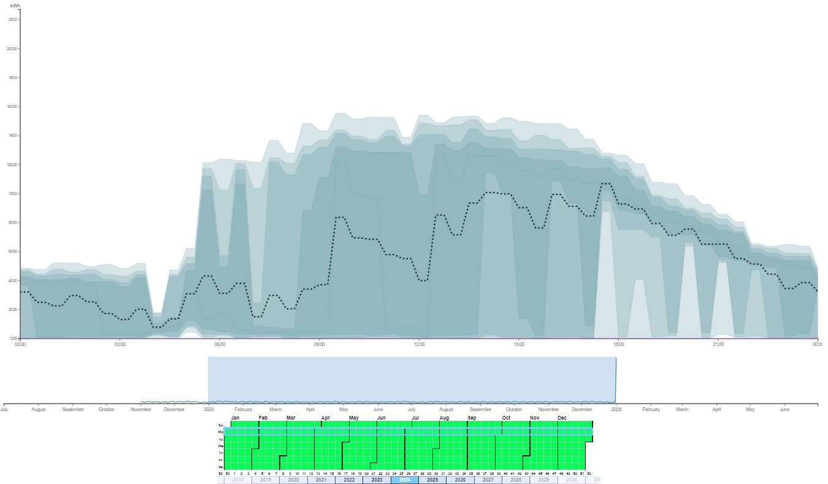
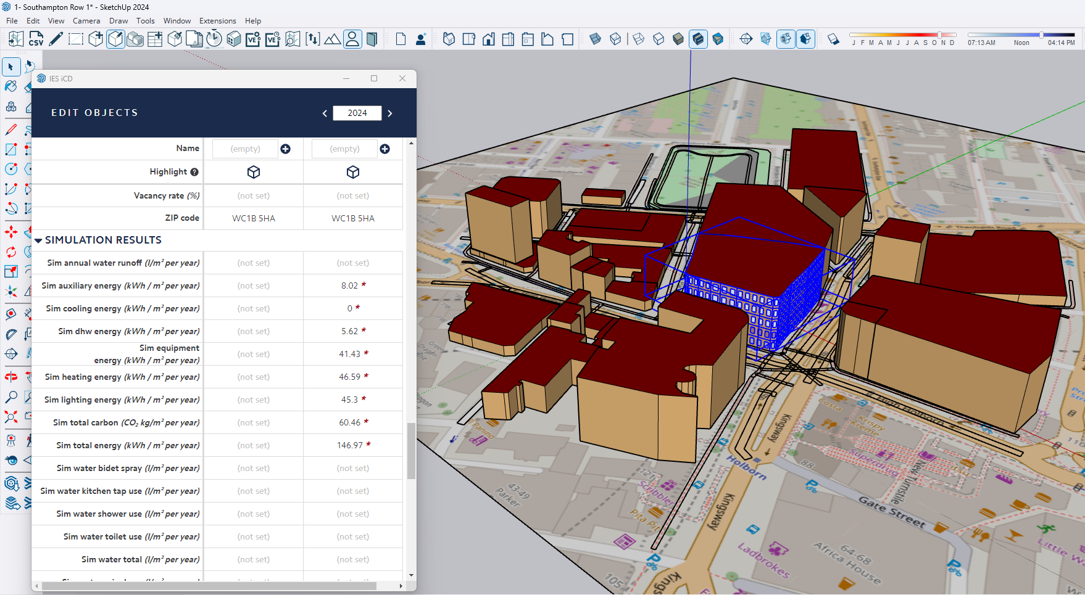
Optimisation & Building Analytics
Data collection
Familiarisation with BMS & Site
Locate historical data & download
Analysis
Create a model from aggregated BMS data
Interpretation
Prioritise measures
Discussions with facilities management
Outputs
Action list
Data model
Report
Obtain building energy data
Draft optimisation measures & assign actions
Analyse trends to identify improvement measures
Generate thermal model
Run scenario models to quantify impacts improvement measures
Process

Slide 4
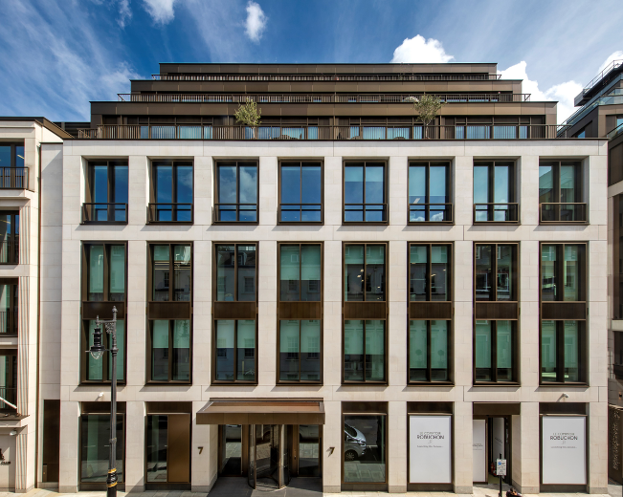
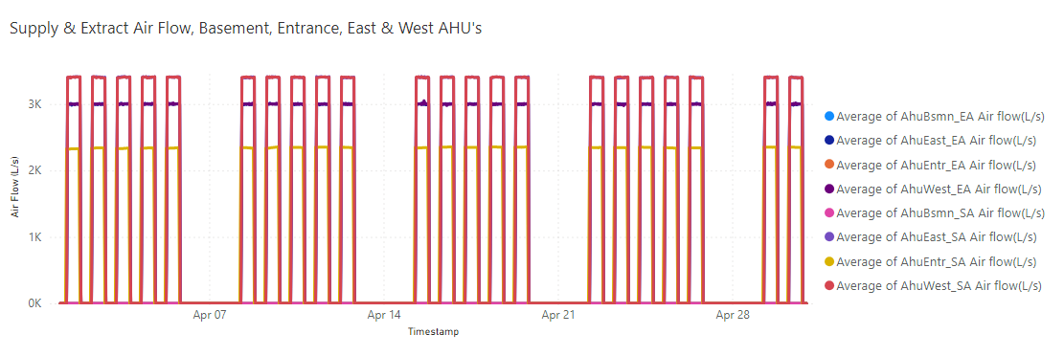
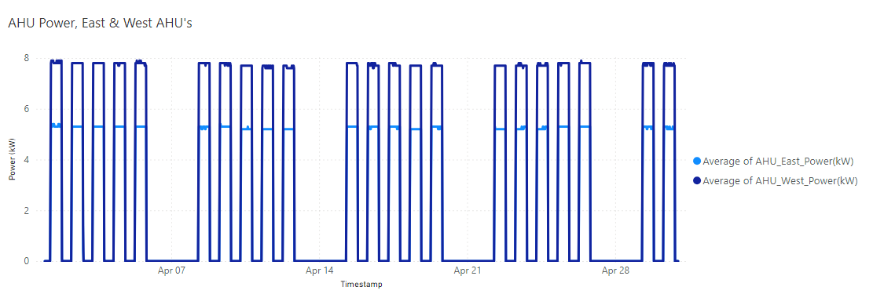
Demand Based Ventilation
Data Analysis
Health & Wellbeing | Building Performance | Balance
Good internal air quality. | Over-ventilation with associated heating & cooling of incoming air. | Adapt Ventilation to VAV. £6,922 pa

Slide 5
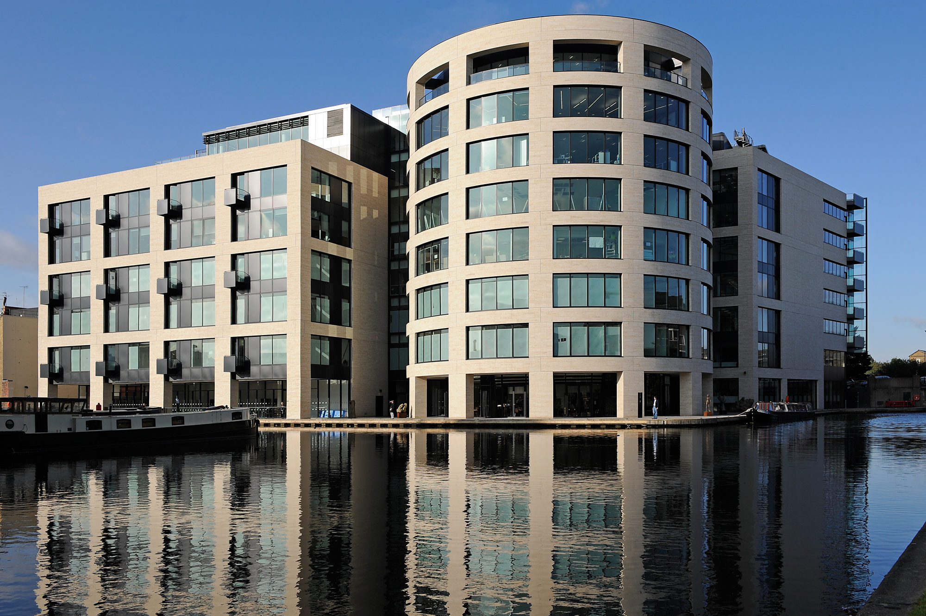
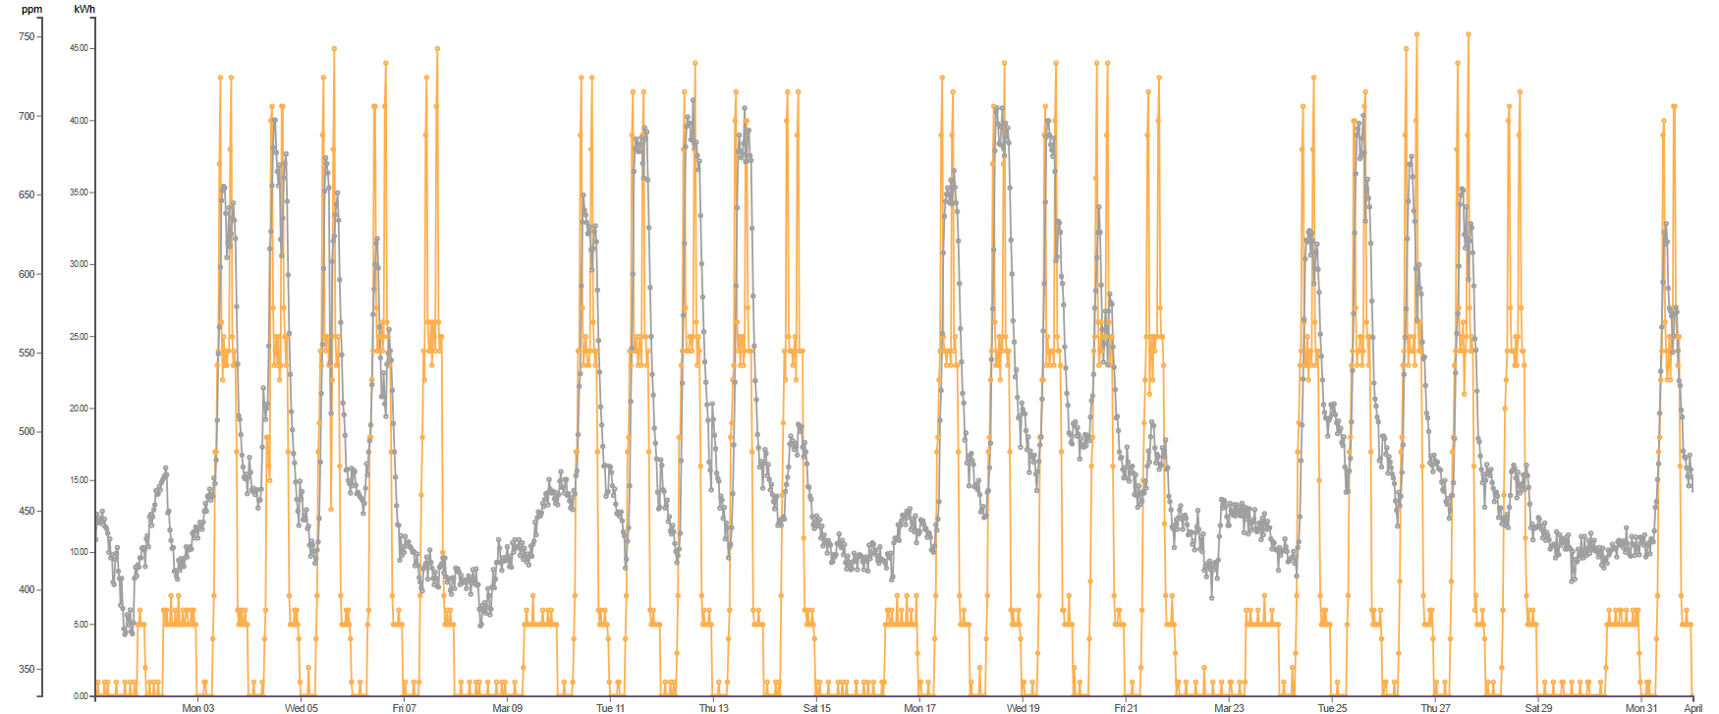
Ventilation
Data Analysis
Health & Wellbeing | Building Performance | Balance
Control of air quality. (Well Target 800ppm) | Overventilation, heating and cooling for make-up air. | Change AHU schedule & adjust PPM level £62,000 pa

Slide 6
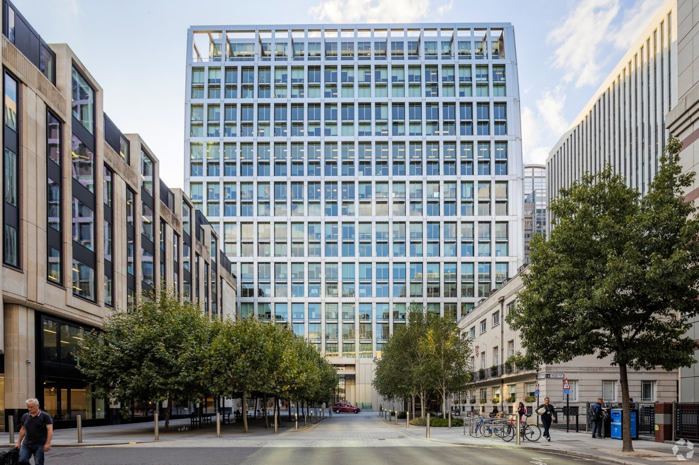
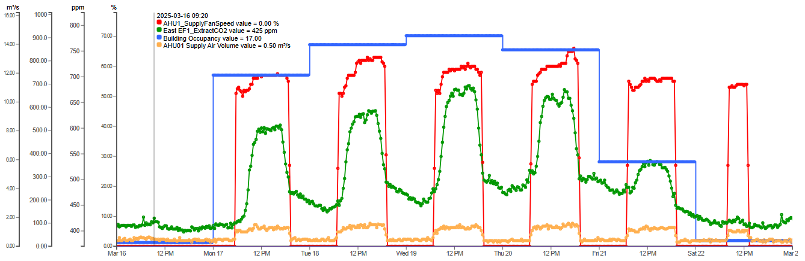
Ventilation
Current minimum supply fan speed 50%
Maximum Outdoor CO₂ con. (ppm)
Data Analysis
Health & Wellbeing | Building Performance | Balance
Control of air quality. (Well Target 800ppm) | Overventilation, heating and cooling for make-up air. | Reduce AHU output, schedule & adjust PPM level £TBC

Slide 7
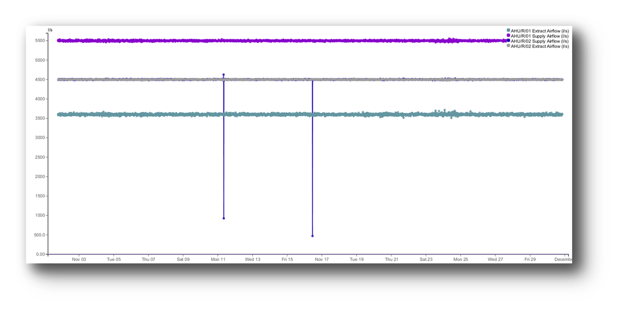
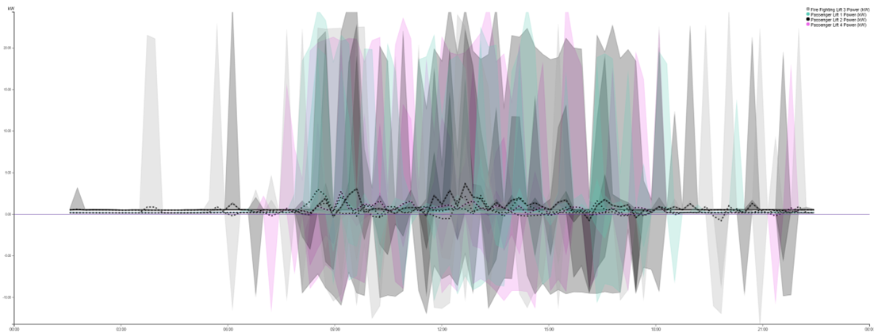
Ventilation / Operating Hours
Data Analysis

Slide 8
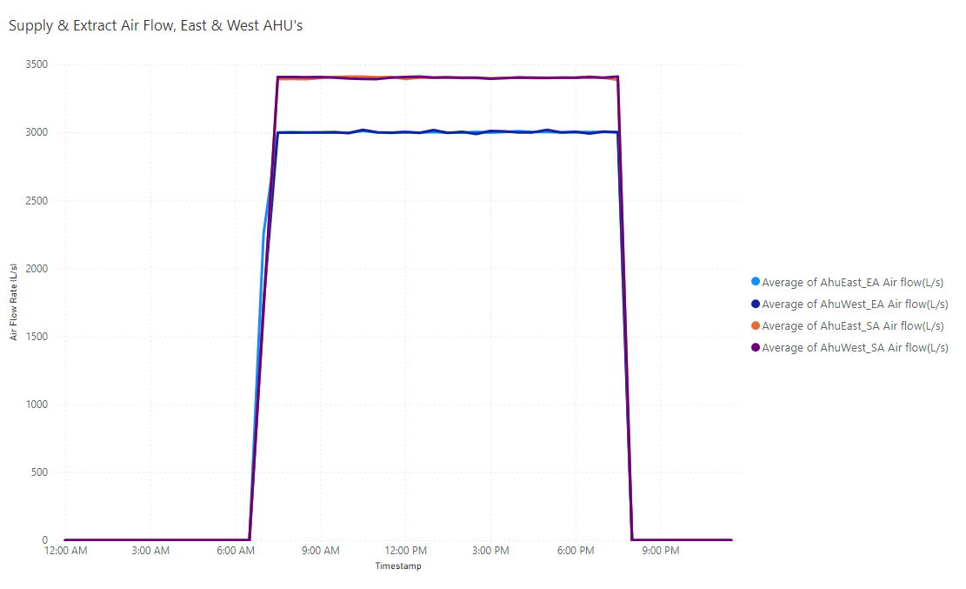
Building Over-Pressurisation
Data Analysis
Health & Wellbeing | Building Performance | Balance
Reducing draughts from infiltration. | Over pressurisation is 13%, missed opportunity to recover heat. | Re-pressure test and adjust ventilation rates. £711 pa

Slide 9
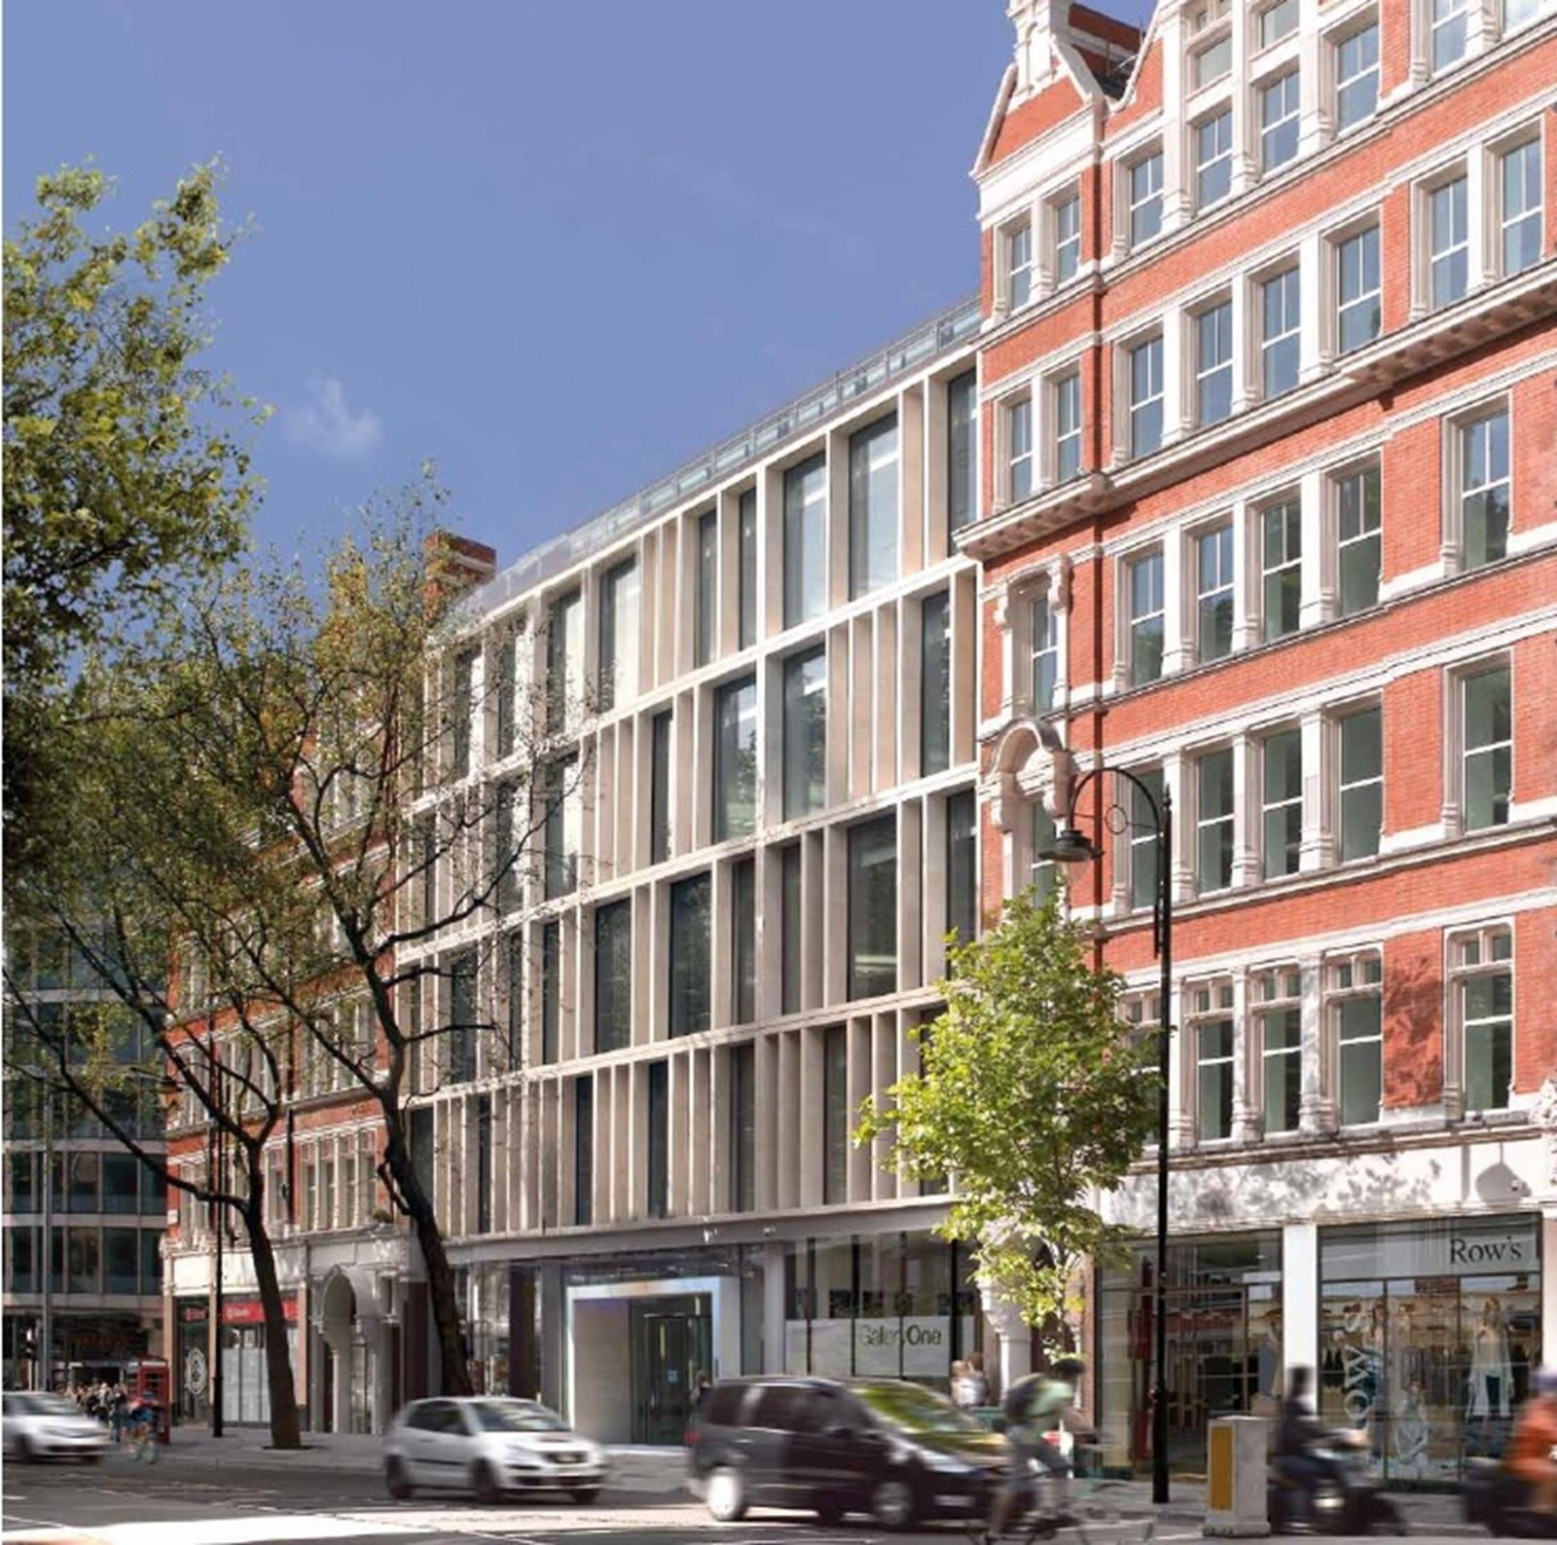
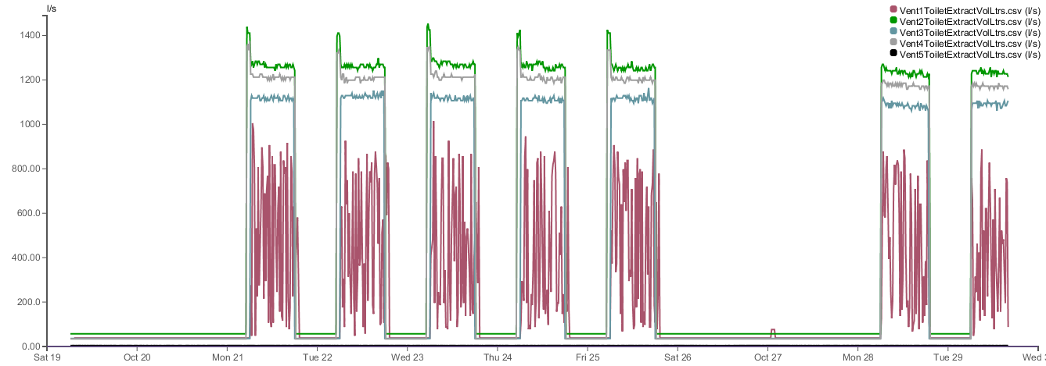
Toilet Extract Ventilation
CASE Study
Health & Wellbeing | Building Performance | Balance
Control of air quality. | Overventilation, heating and cooling for make-up air. | PIR / occupancy control £22,200 pa

Slide 10
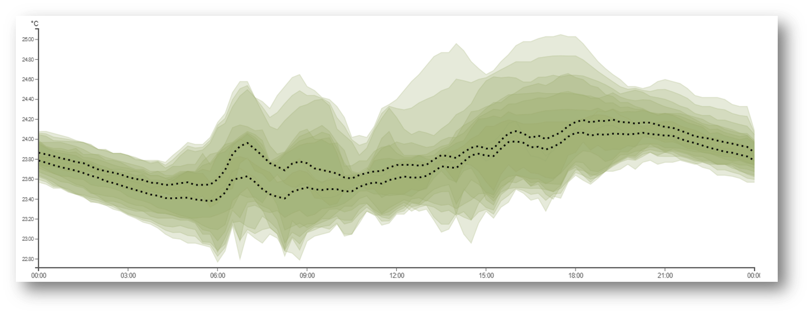
Reception Heating
Data Analysis
Health & Wellbeing | Building Performance | Balance
Warm reception staff. | Heat wasted into upper atrium. | Stop draughts & lower htg setpoint. £5,738 pa

Slide 11
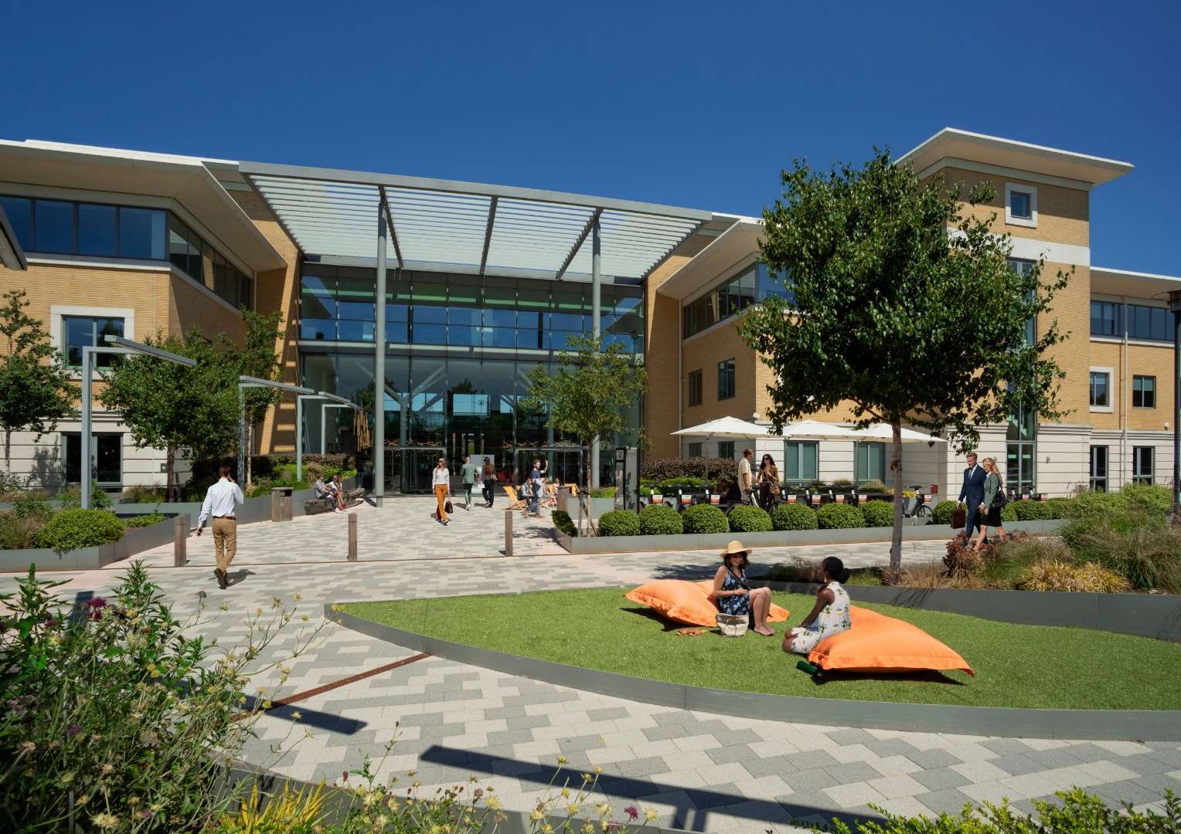
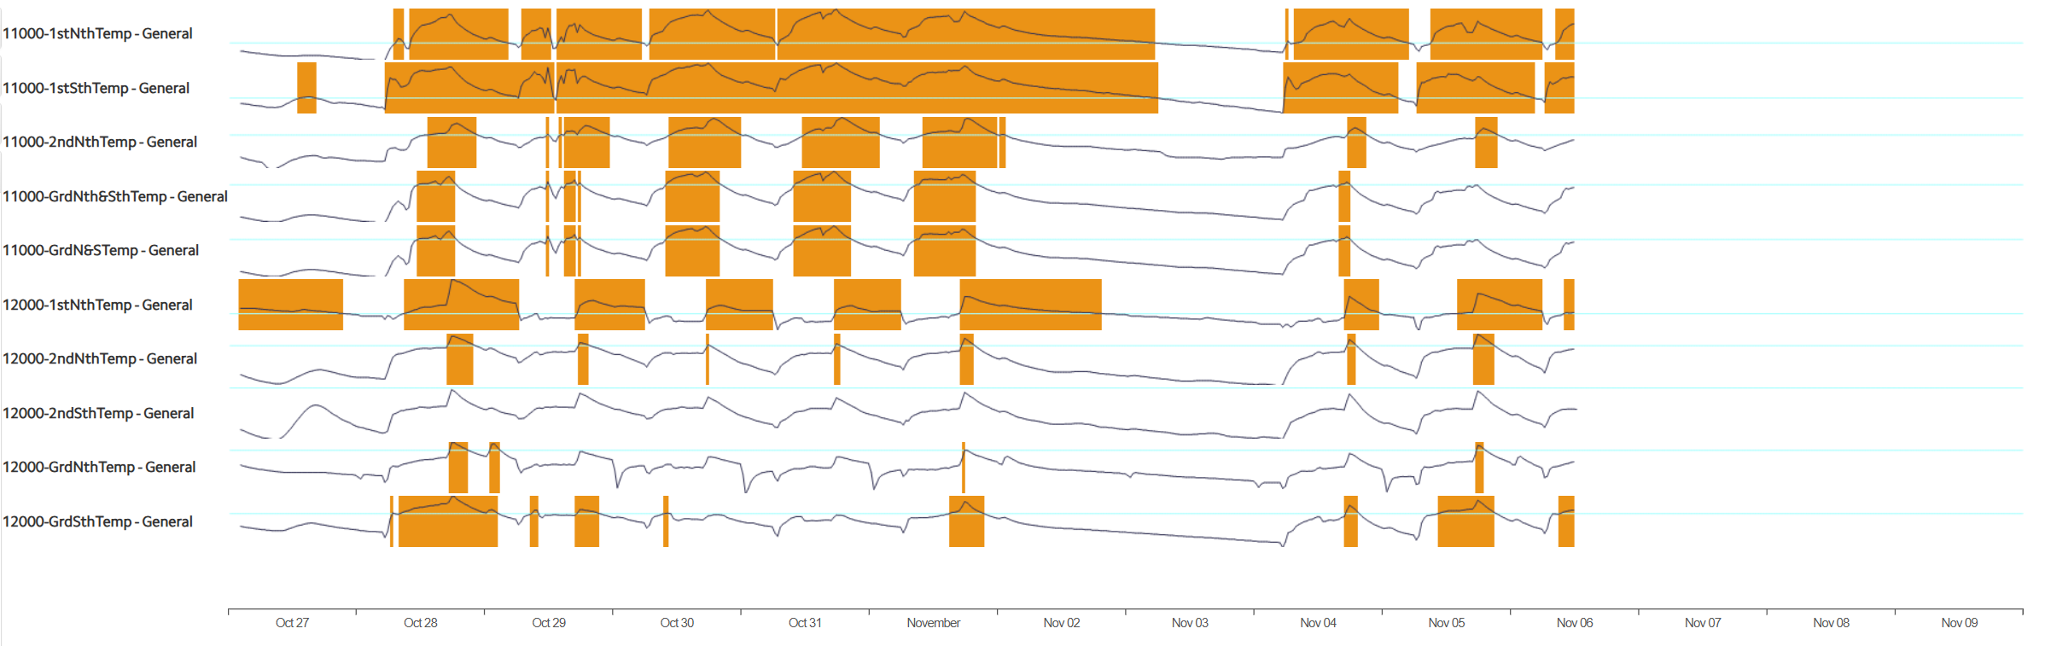
Office Space Temperature Overheating
Data Analysis
Health & Wellbeing | Building Performance | Balance
Temperature control. | Wasted heat. | AHU setpoints, global resets £23,575

Slide 12
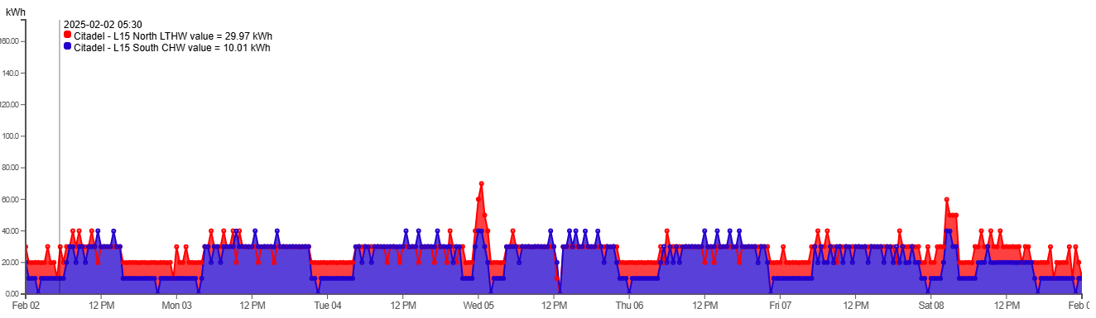
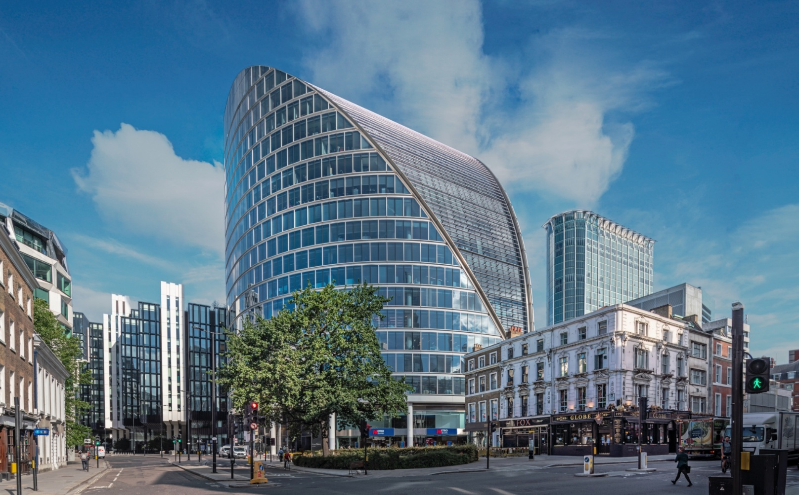
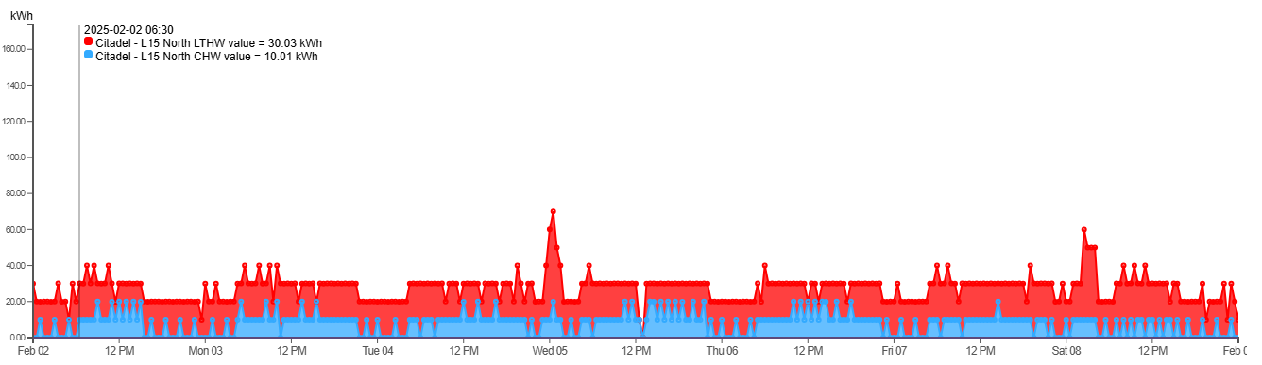
FCU Control
Data Analysis
Health & Wellbeing | Building Performance | Balance
Temperature control. | Simultaneous heating & cooling. | Tenant engagement, AHU setpoint, global resets £29,750

Slide 13
Mall Lighting & Dimming
 | Mon-Fri |  |  |  |  |  |  |  |  |  |  |  |  |  |  |  |  |  |  |  |  |  |  |  |  |  |  |  |  |  |  |  |  |  |  |  |  |  |  |  |  |  |  |  |  |  |  |  |  |  | Saturday |  |  |  |  |  |  |  |  |  |  |  |  |  |  |  |  |  |  |  |  |  |  |  |  |  |  |  |  |  |  |  |  |  |  |  |  |  |  |  |  |  |  |  |  |  |  |  |  |  | Sunday
Store opening times
ODEON-Cinema
WC lights schedule
Cleaning Lighting
Cornice Lighting
Mall Lighting
Xmas Lighting
 | 00:00 |  | 01:00 |  | 02:00 |  | 03:00 |  | 04:00 |  | 05:00 |  | 05:00 |  | 06:00 |  | 07:00 |  | 08:00 |  | 09:00 |  | 10:00 |  | 11:00 |  | 12:00 |  | 13:00 |  | 14:00 |  | 15:00 |  | 16:00 |  | 17:00 |  | 18:00 |  | 19:00 |  | 20:00 |  | 21:00 |  | 22:00 |  | 23:00 |  | 00:00 |  | 01:00 |  | 02:00 |  | 03:00 |  | 04:00 |  | 05:00 |  | 05:00 |  | 06:00 |  | 07:00 |  | 08:00 |  | 09:00 |  | 10:00 |  | 11:00 |  | 12:00 |  | 13:00 |  | 14:00 |  | 15:00 |  | 16:00 |  | 17:00 |  | 18:00 |  | 19:00 |  | 20:00 |  | 21:00 |  | 22:00 |  | 23:00 |  | 00:00 |  | 01:00 |  | 02:00 |  | 03:00 |  | 04:00 |  | 05:00 |  | 05:00 |  | 06:00 |  | 07:00 |  | 08:00 |  | 09:00 |  | 10:00 |  | 11:00 |  | 12:00 |  | 13:00 |  | 14:00 |  | 15:00 |  | 16:00 |  | 17:00 |  | 18:00 |  | 19:00 |  | 20:00 |  | 21:00 |  | 22:00 |  | 23:00
Reduction in Lighting Output – dimming periods
Christmas Lights Off In Summer
Data Analysis
Health & Wellbeing | Building Performance | Balance
Merchandising sales / bright & airy. | Wasted power during daylight hours. | Basic daylight dimming. £9,130

Slide 14
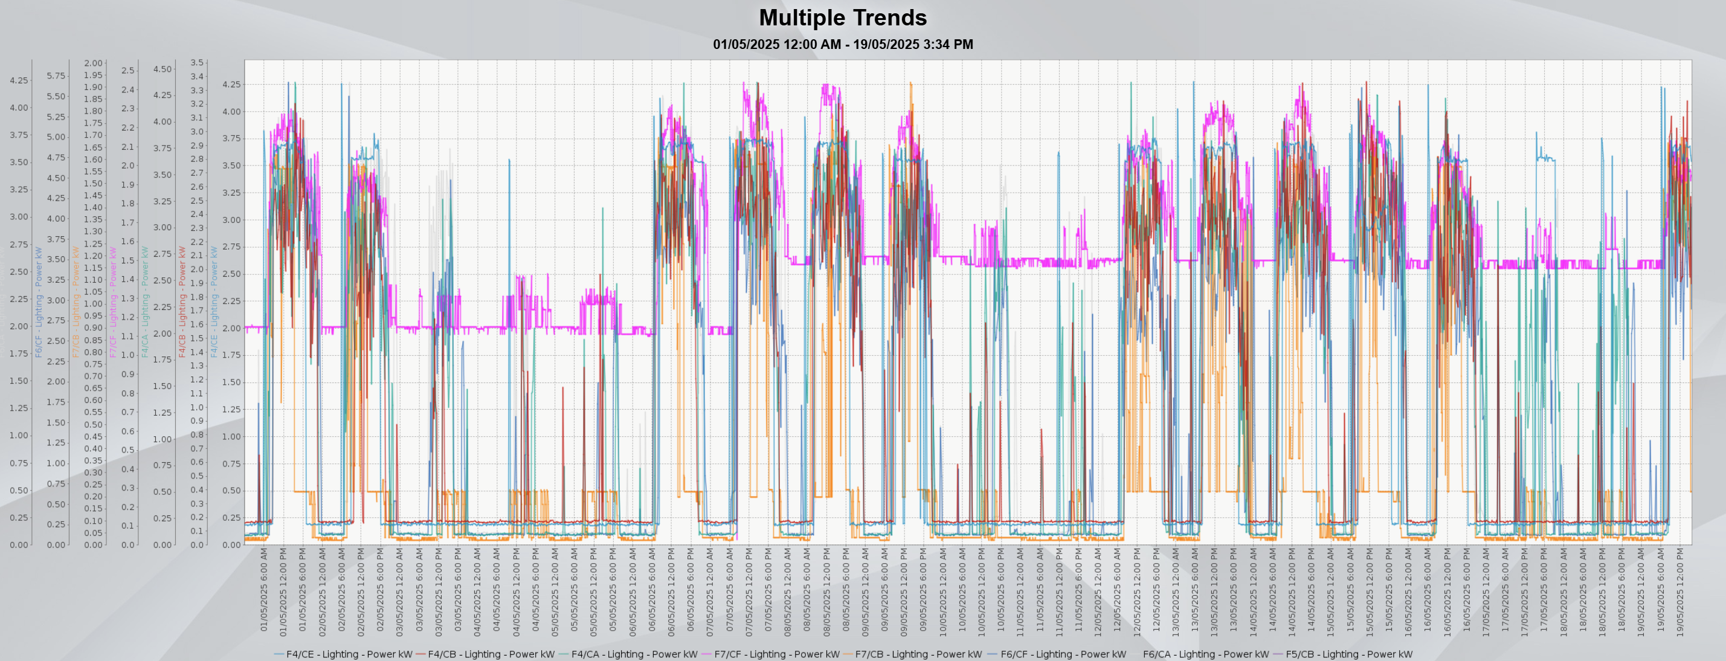
Circadian Lighting
Data Analysis
Health & Wellbeing | Building Performance | Balance
Diurnal lighting output | Wasted power during daylight hours. | Energy saving = 10-30% Maintenance = 10-20% Productivity = 2-10%

Slide 15
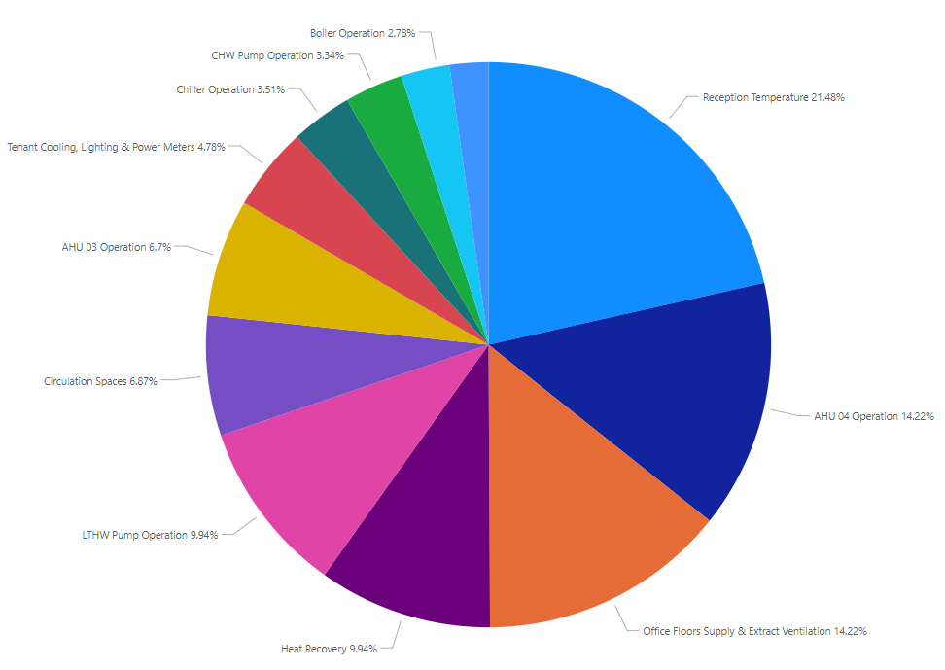
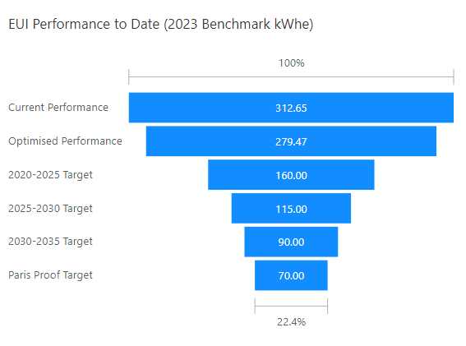
Optimisation Potential
Summary of Measures
Energy Savings: | 11%
Cost Savings: | £65.5k
CO₂ Savings: | 72,000 kgCO₂/yr

Slide 16

Thanks
peter.brown@savills.com

