Slide 1
Tackling Indoor Air Pollution Air Filtration
CIBSE HVAC GROUP
December 2021
Peter Dyment
peter.dyment@camfil.com
www.camfil.co.uk

Slide 2
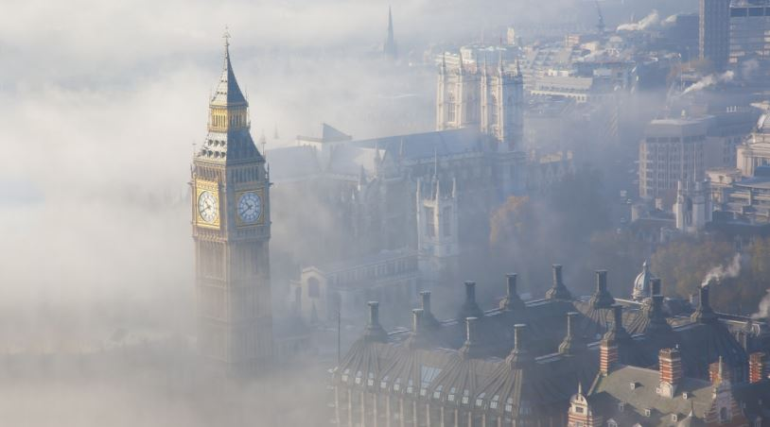
Outdoor (urban) air quality is a major health issue
Air pollution shortens the lives of more than 50,000 people in the UK every year
The WHO estimates the total annual cost of air
pollution to the UK economy at £53bn, or
3.7% of GDP
Risk to Health from
Traffic air pollution
NOx and PM1 2.5 10
SOx H2S O3 …..
High air pollution also results in low birth weights, and has a negative impact on cognitive development
Urban air quality is the top environmental risk factor for premature deaths in Europe Source: The State of Natural Capital report
Traffic air pollution PM1 and NO2 is a WHO group 1 carcinogen. No safe level of exposure.

Slide 3
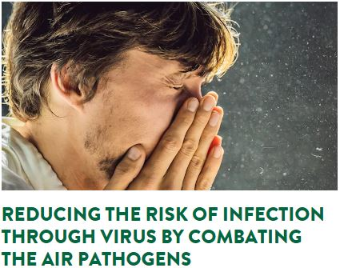
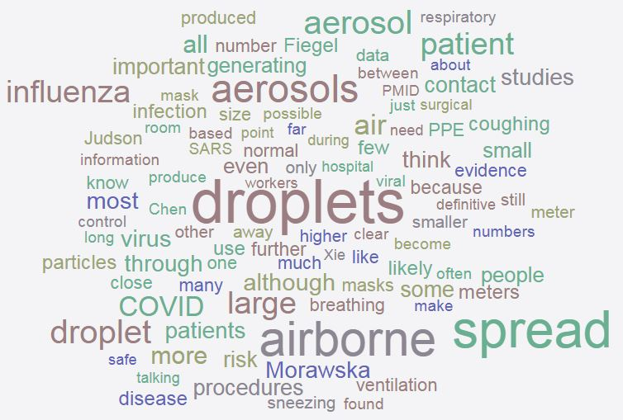
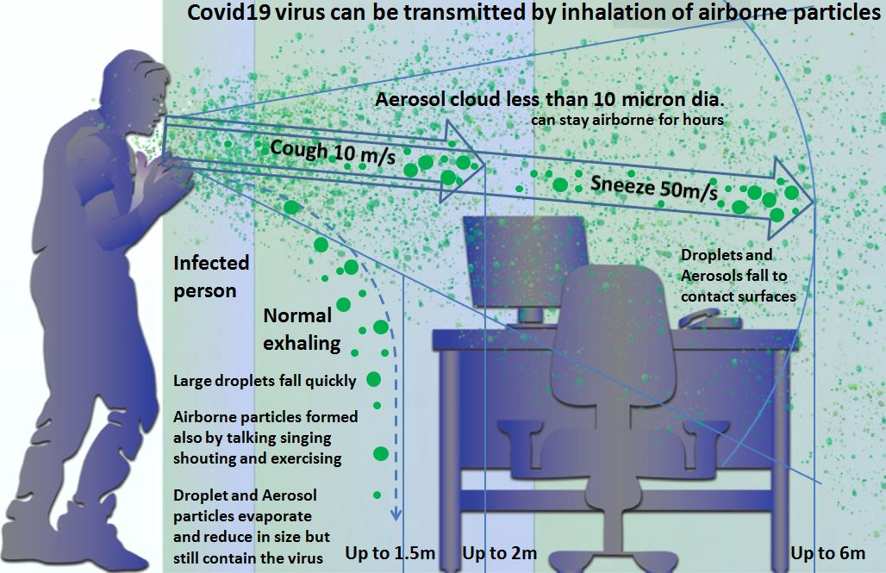
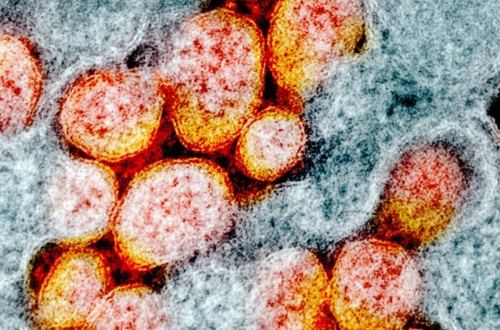
“In the mind of scientists working on this, there’s absolutely no doubt that the virus spreads in the air,” says aerosol scientist Lidia Morawska at the Queensland University of Technology in Brisbane, Australia. “This is a no-brainer.”
Mechanical Air Filtration has an important role in delivering clean indoor air into buildings
Air can also be cleaned by recirculation air cleaners and purifiers with tested air filters
NEW - Covid19 virus size at 0.12μm to 0.16μm
SARS-CoV-2
Note: 1mm = 1 micron = 1 thousandth of a mm. Small

Slide 4
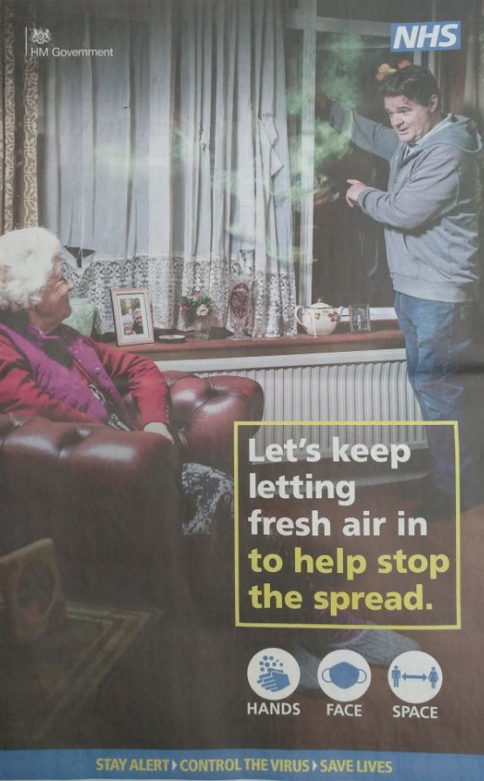
Evolution of Government Covid19 guidance over time
is not defined but can be considered as outdoor air. It is not always clean air.
What about Winter cold?
can be infectious aerosols. Which particle size carries greatest risk of infection?
can be removed by air filters of the required filtration tested efficiency
Airborne transmission
Covid19 Particles in air
Face masks reduce Particles
Autumn 2020
Last month 2021
This week 2021

Slide 5
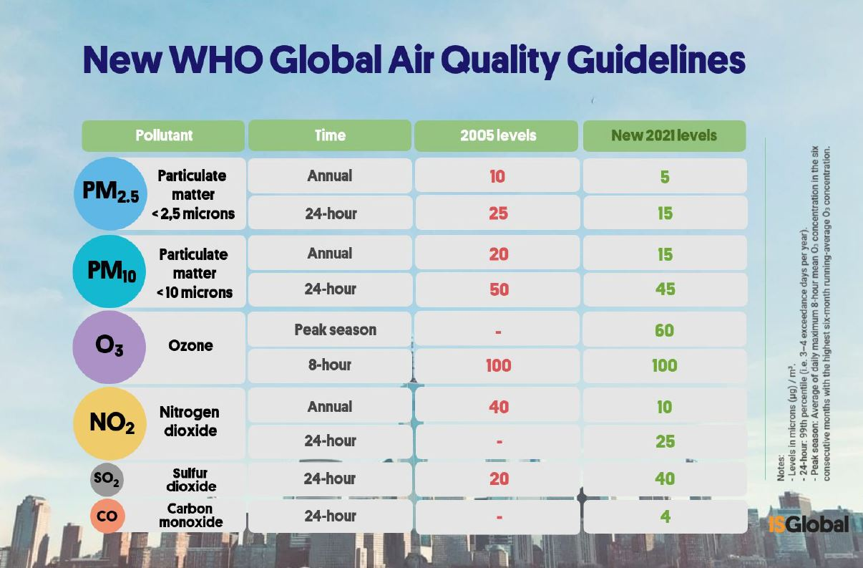
NEW WHO LIMITS
Covid19 / Traffic
Traffic
“Guidelines are applicable to both outdoor and indoor environments globally. Thus, they cover all settings where people spend time”.
Changes deliberated over for 16 years by hundreds of the world’s top medical health experts with report supported by about 250 study papers

Slide 6
BS EN 16798-3:2017 IAQ Filter requirements
BS EN ISO 16890:2016 Particle filter testing
BS EN ISO 10121-2:2013 Molecular filter testing
Eurovent 4-23 (Oct 18) Supply Air filter requirements
WHO guidelines Air pollution exposure limits
The convergence of standards and guidelines now provides a means of selecting air filters to ensure healthy clean air for people to breathe inside city buildings – especially public buildings offices schools and hospitals
There has also been published IAQ guidance by Well Building, BREAM LEED and ASHRAE
https://shop.bsigroup.com/products/energy-performance-of-buildings-ventilation-for-buildings-for-non-residential-buildings-performance-requirements-for-ventilation-and-room-conditioning-systems-modules-m5-1-m5-4/tracked-changes
https://shop.bsigroup.com/products/air-filters-for-general-ventilation-technical-specifications-requirements-and-classification-system-based-upon-particulate-matter-efficiency-epm/standard
https://landingpage.bsigroup.com/LandingPage/Series?UPI=BS%20EN%20ISO%2010121
https://eurovent.eu/?q=content/eurovent-423-2020-selection-en-iso-16890-rated-air-filter-classes-third-edition-english
https://apps.who.int/iris/handle/10665/345329

Slide 7
Using BS EN16798-3:2017 standard guidance to select correct air filtration efficiency
Based on the outdoor air (ODA) and supply air (SUP) categories, it is then possible to determine the required final filter efficiencies to achieve the specified clean indoor air
Outdoor Air |  |  | Supply Air
 |  |  | SUP1 IAQ | SUP2 IAQ | SUP3 | SUP4 | SUP5
 |  |  | PM_{2.5}≤2.5µg/m³ PM10≤5µg/m³ | PM_{2.5}≤5µg/m³ PM10≤10µg/m³ | PM_{2.5}≤7.5µg/m³ PM10≤15µg/m³ | PM_{2.5}≤10µg/m³ PM10≤20µg/m³ | PM_{2.5}≤15µg/m³ PM10≤30µg/m³
Category | PM_{2.5} | PM₁₀ | ePM_{1 a} | ePM_{1 a} | ePM_{2.5 b} | ePM₁₀ | ePM₁₀
ODA1 | ≤10µg/m³ | ≤20µg/m³ | 70% _{a} | 50% _{a} | 50% _{a} | 50% | 50%
ODA2 | ≤15µg/m³ | ≤30µg/m³ | 80% _{a} | 70% _{a} | 70% _{a} | 80% | 50%
ODA3 | >15µg/m³ | >30µg/m³ | 90% _{a} | 80% _{a} | 80% _{a} | 90% | 80%
a - minimum filtration requirements ISO ePM1 % refer to final filter stage
b - minimum filtration requirements ISO ePM2.5 % refer to final filter stage

Slide 8
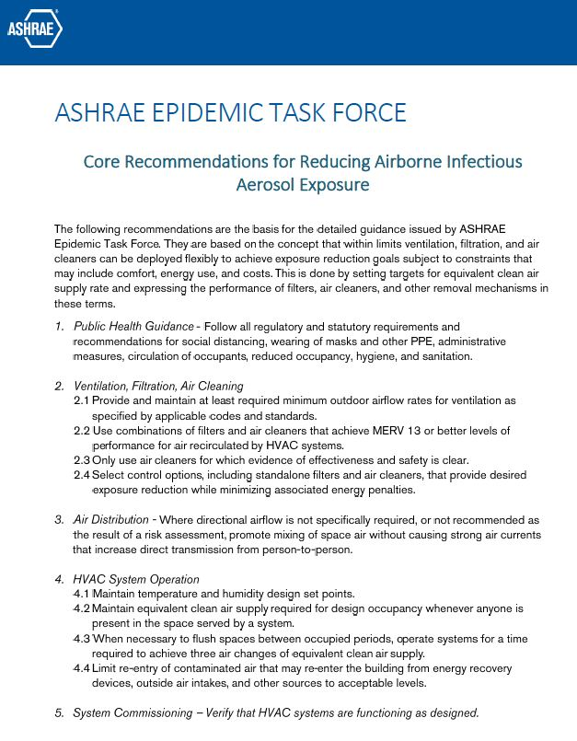
Core Recommendations for Covid19 and traffic air pollution with CO2 reduction (Energy efficiency)
Core Strategy proposal consists of delivering clean healthy indoor air by:
Utilizing and upgrading air filtration in existing mechanical ventilation systems where possible.(Existing legacy HVAC)
Total efficiency for supply side air filters upgraded to ePM1 80% minimum (WHO limit factors) (BS ISO16890)
Recirculation/Extract air filters upgraded to minimum ePM1 60% or better. (WHO limit factors) (BS ISO16890)
Use of low energy air filters (LEAF) for best energy efficiency and long life. CO2 reduction. (COP26)
Use of Hepa H14 class standalone air cleaners where main ventilation systems do not exist or are insufficient.
Maintenance – Monitor – Record data - Readjust
Use Air monitoring to confirm clean air benefits are being delivered. Use air monitor control function if possible.
https://www.ashrae.org/file%20library/technical%20resources/covid-19/core-recommendations-for-reducing-airborne-infectious-aerosol-exposure.pdf

Slide 9
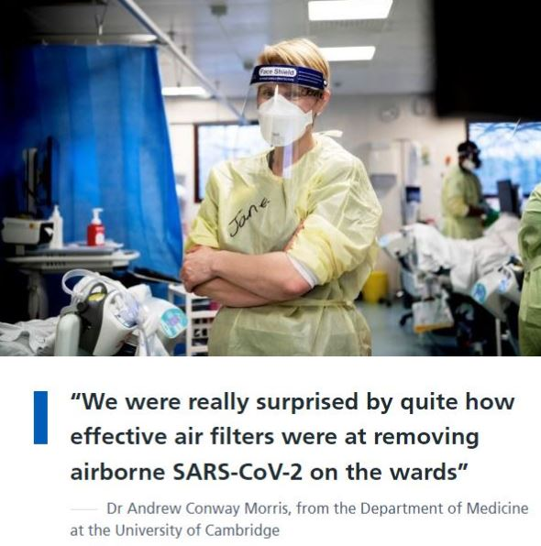
Addenbrookes Hospital Study
January 18th to February 5th 2021 - beds in the ward and ICU were at 100% occupancy
Results of control tests (No air filtration in operation)
We were able to detect SARS-CoV-2 on all sampling days; RNA was detected in both the medium (1-4μM) and the large (>4μM) particulate fractions.
SARS-CoV-2 RNA was not detected in the small (<1μM)
“Cleaner air will reduce the risk of airborne disease transmission”
Professor Stephen Baker, from the Cambridge Institute of Therapeutic Immunology and Infectious Disease at the University of Cambridge
https://www.cuh.nhs.uk/news/air-filters-on-wards-remove-almost-all-airborne-covid-virus/

Slide 10
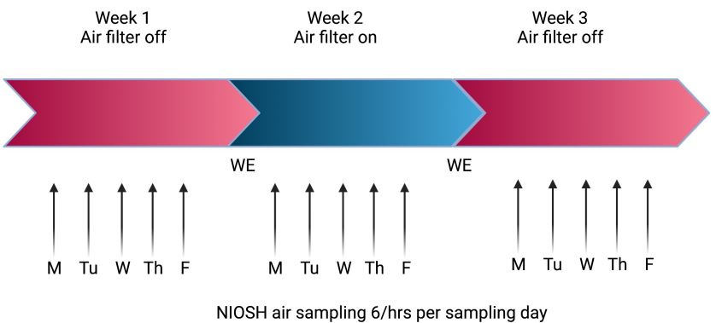
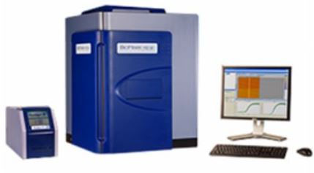
Addenbrookes Hospital Study
January 18th to February 5th 2021 - beds in the ward and ICU were at 100% occupancy
When no air filtration was in operation
SARS-CoV-2 RNA was not detected in the small airborne particles (<1μM)
Particle size sampling
BC251 Aerosol Sampler
Proposition:
If no Covid19 RNA was detected in any of the samples taken for particles
Below 1 micron (<1μM) then infection risk resides in particles above 1μM
Therefore:
ISO16890 tested HVAC filters class ePM1 to high efficiency are capable of removing infectious particles.This can be in any building ventilation system,office, school, home
“Cleaner air will reduce the risk of airborne disease transmission”
Professor Stephen Baker, from the Cambridge Institute of Therapeutic Immunology and Infectious Disease at the University of Cambridge

Slide 11
Addenbrookes Hospital Study
These data are consistent with our observations, suggesting that aerosol precautions may be more important in conventional wards than in well defined ‘aerosol risk areas’.

Slide 12
Addenbrookes Hospital Study
These data are consistent with our observations, suggesting that aerosol precautions may be more important in conventional wards than in well defined ‘aerosol risk areas’.

Slide 13
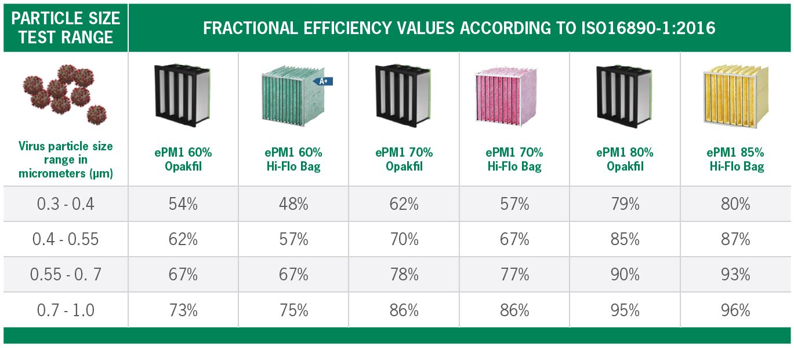
BS EN ISO 16890:2016 gives accurate test data in the small particle size range
It also allows for calculation of multi stage AHU HVAC filter efficiency
NOTE: These two filters can be used as single stage system

Slide 14
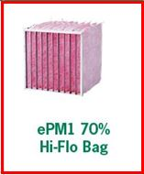
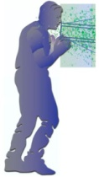
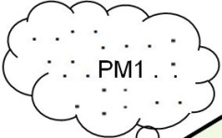
BS EN ISO 16890:2016 gives accurate test data in the small particle size range
It also allows for calculation of multi stage AHU HVAC filter efficiency
Note: recirculation of clean filtered air could reduce heating/cooling energy costs by up to 80% (legacy systems)
Single pass PM1 efficiency. (3stage)
PM2.5 (3stage)
efficiency 99.2%
Example of HVAC AHU filter system effective at removing airborne aerosol particles
Traffic air pollution etc
Recirc Air damper
Recirc Air
Outdoor Air
Indoor Air
0 deg.C?
Supply Air
20 deg.C?
Recirculation air cycle 5 airchanges per hour? (cycle time12 mins)
10 airchanges per hour? (cycle time 6 mins)

Slide 15
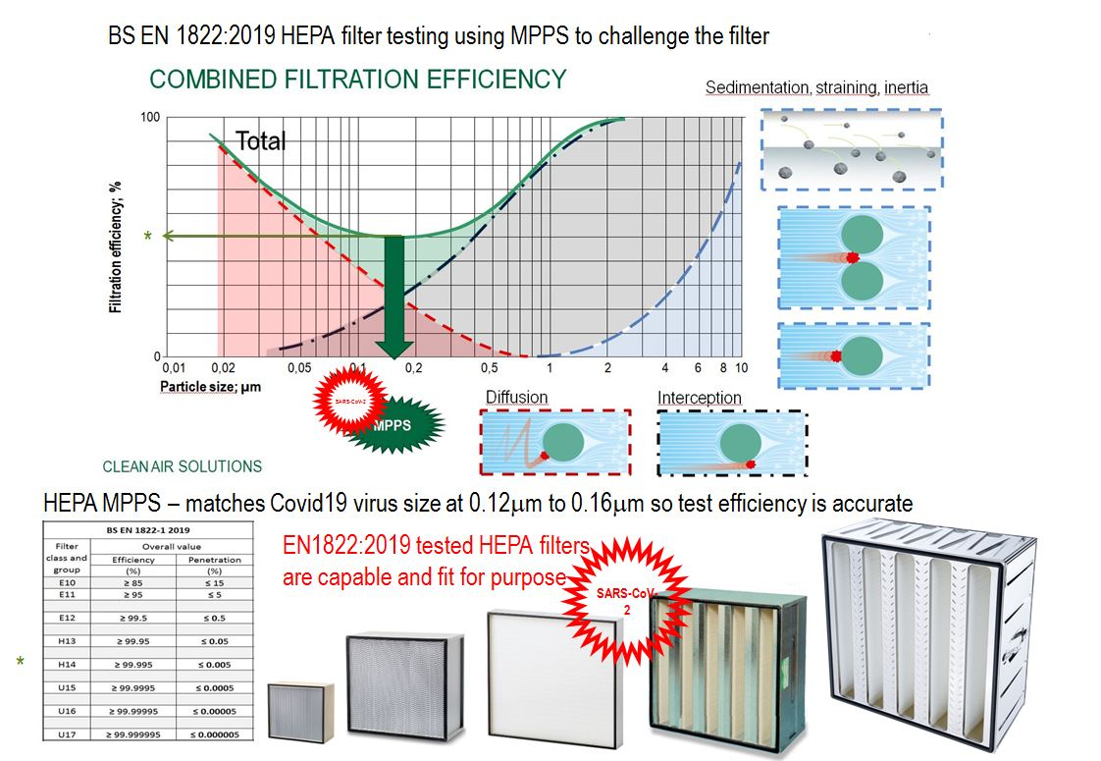
Note: EN1822 and ISO29463 are related HEPA test standards

Slide 16
Air purifier unit

Slide 17
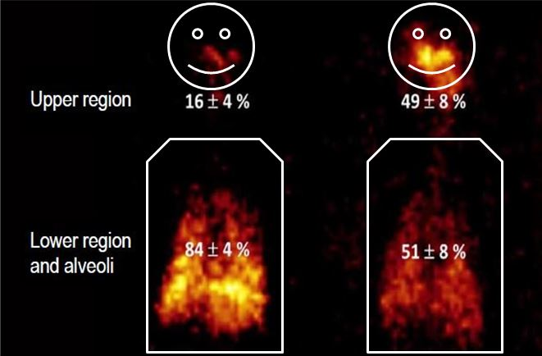
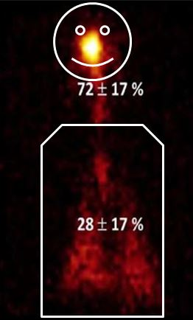
Proof that PM1 particles make deep lung penetration
Reference : Study by Karolinska Institute Stockholm

Slide 18
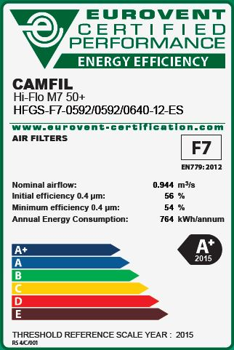
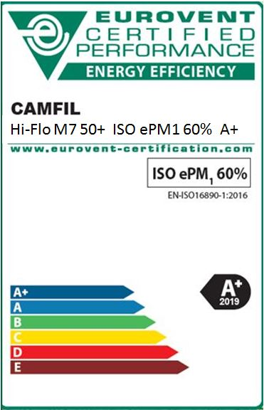
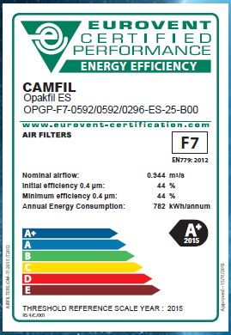
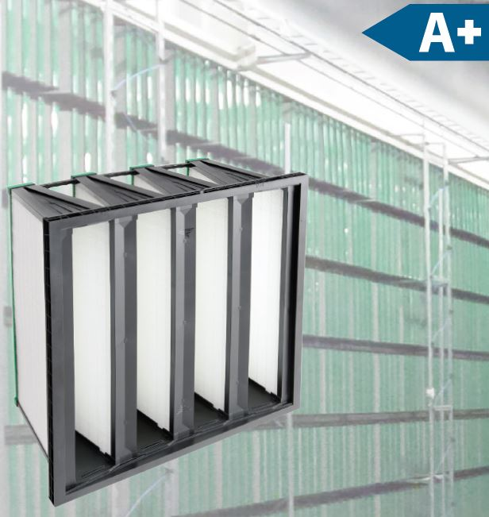
Eurovent A+ rated filters
New BS EN ISO 16890:2016 tested labels

Slide 19
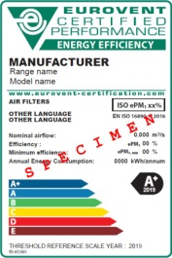
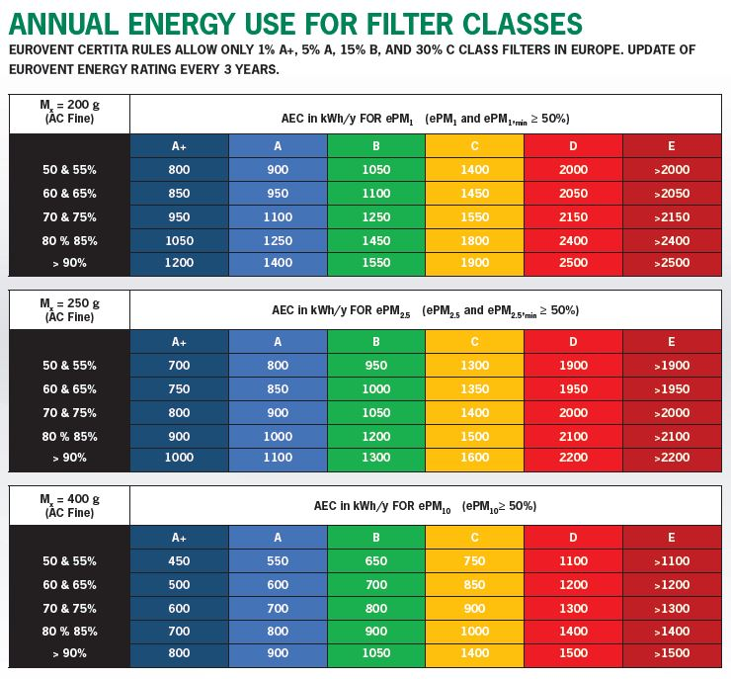
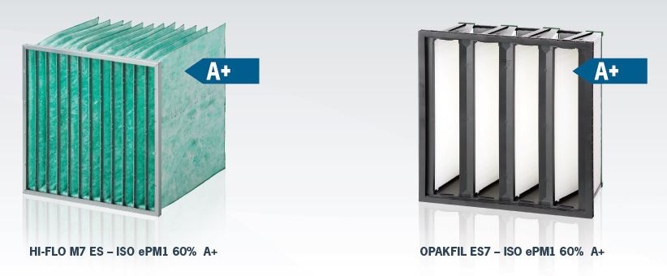
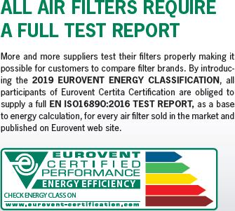
Based on BS EN ISO 16890:2016

Slide 20
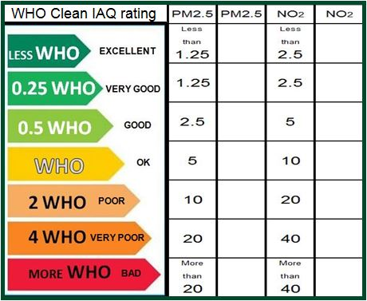
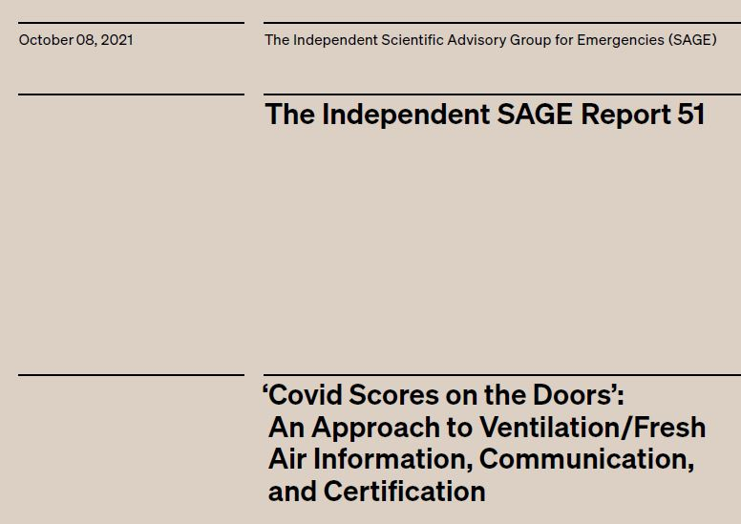
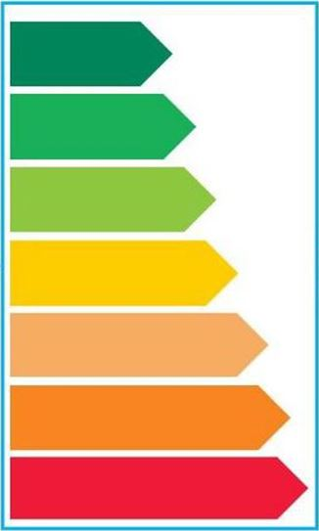
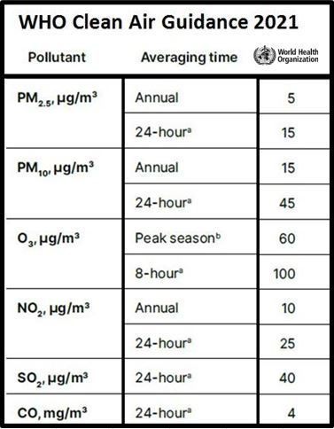
Suggested WHO scores on the doors approach
advocated by independent SAGE Report 51
Has the advantage of staying in step with any
future changes made to WHO exposure limits.
Combines with traffic light system to give good visual display similar to Eurovent energy rating.
Uses μg/M3 generally as WHO limit reporting.
Air pollutant list can be expanded to suit.
https://www.independentsage.org/wp-content/uploads/2021/10/Ventilation-Certification-and-Ratings-FINAL-for-website-1.pdf

Slide 21
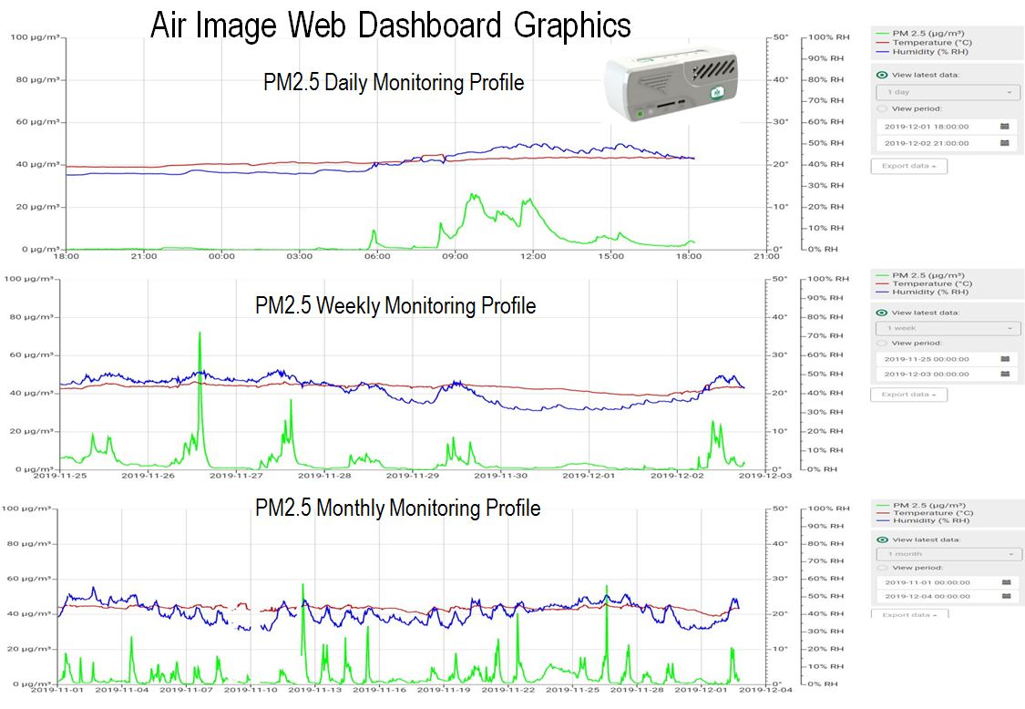

Slide 22
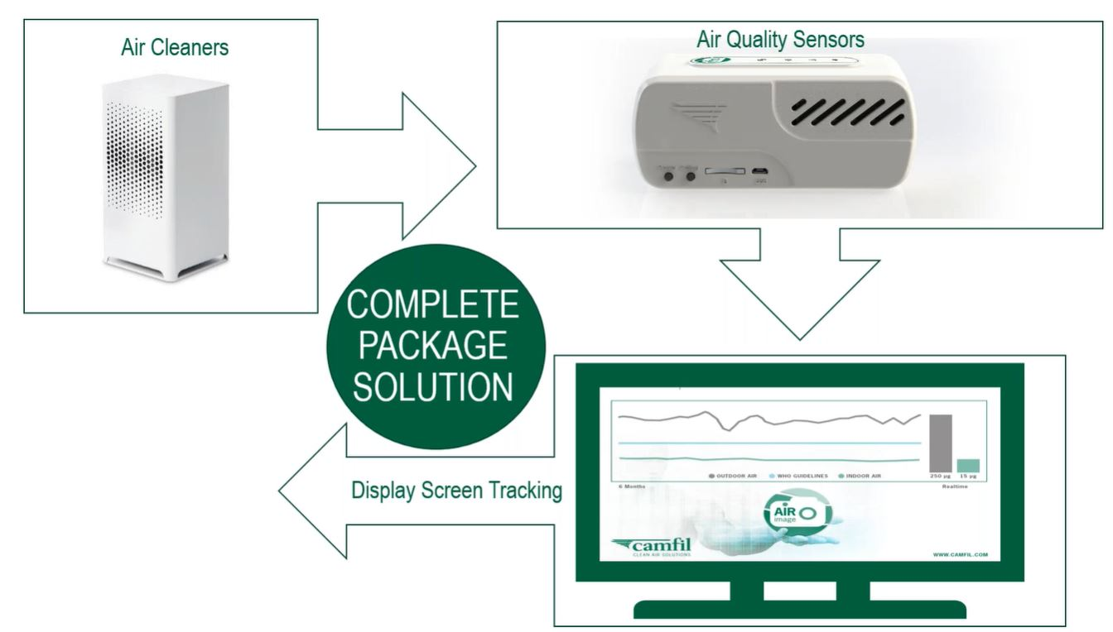
Clean Healthy Air - Control and demonstration of performance
Clean Healthy
Indoor Air at
Minimum cost

Slide 23
Core Recommendations for Covid19 and traffic air pollution with CO2 reduction (Energy efficiency)
Core Strategy proposal consists of delivering clean healthy indoor air by:
Utilizing and upgrading air filtration in existing mechanical ventilation systems where possible.(Existing legacy HVAC)
Total efficiency for supply side air filters upgraded to ePM1 80% minimum (WHO limit factors) (BS ISO16890)
Recirculation/Extract air filters upgraded to minimum ePM1 60% or better. (WHO limit factors) (BS ISO16890)
Use of low energy air filters (LEAF) for best energy efficiency and long life. CO2 reduction. (COP26)
Use of Hepa H14 class standalone air cleaners where main ventilation systems do not exist or are insufficient.
Maintenance – Monitor – Record data - Readjust
Use Air monitoring to confirm clean air benefits are being delivered. Use air monitor control function if possible.
https://www.ashrae.org/file%20library/technical%20resources/covid-19/core-recommendations-for-reducing-airborne-infectious-aerosol-exposure.pdf

Slide 25
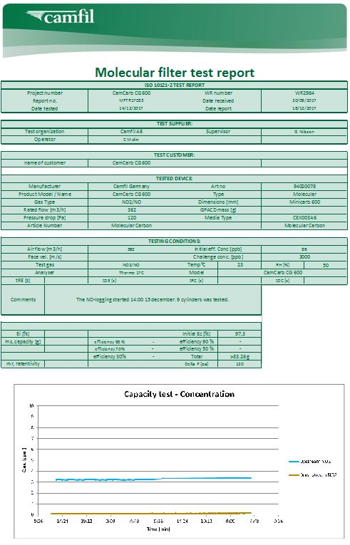
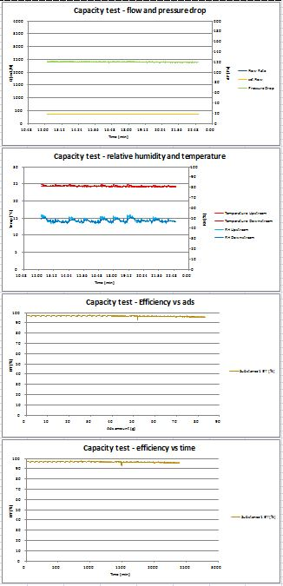
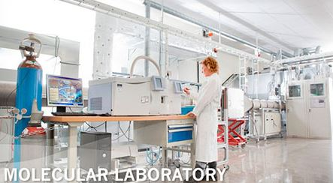
ISO 10121-1:2014 ISO101-2:2013
International Standard
Test method for assessing the 1.performance of gas phase media and 2.air cleaning devices for general ventilation (GPACD)
Testing based on four key parameters
Removal efficiency
Capacity
Retentivity
Operating pressure drop

Slide 26
THANK YOU FOR YOUR ATTENTION
www.camfil.com
camfil
camfilgroup
camfil
camfilgroup
CLEAN AIR SOLUTIONS

