Slide 1
THE FUTURE PROSPECTS FOR OUR CITIES
Derek Clements-Croome
CIBSE Resilient Cities Group
September 8 2020

Slide 2
DO WE NEED CITIES
ORIGINS 7000+ YEARS AGO (NEOLITHIC)
Catalhoyuk Turkey 7100 BC -5700 BC
Trading routes hence business centres
Centres for food—markets(agora—gathering places)
Centres for politics, governance
Industrial Revolution growth of cities and centralised infrastructure 1750 onwards
Garden Cities 1900
Populations now vast( Mega + Meta cities)

Slide 3
“ A City should be built to give its inhabitants security and happiness” ---Aristotle
An Intelligent City and Liveable City is
An Accessible City
A Business City
An Attractive City
A City for Living
A Just City

Slide 4
SOME CITY INSPIRERS
Hippodamus of Miletus 498 BC
Archimedes 288 BC
Ebenezer Howard 1850 (Garden City)
Patrick Geddes 1854 (conurbation)
Jan Gehl 1936
Vincent Callebaut current
Masdar, Malaysia, China city develpments

Slide 5
ARE CITIES GOOD OR BAD
POSITIVE
Economy of scale
Social energy of communities- the Buzz
Job opportunities
Ease of communications
Cultural focus
Diversity—London a collection of villages

Slide 6
CITIES
NEGATIVE
Emissions and Pollution
Sprawl
Infection risks higher
Stressful
Loose connection with Nature
Inequality between regions

Slide 7
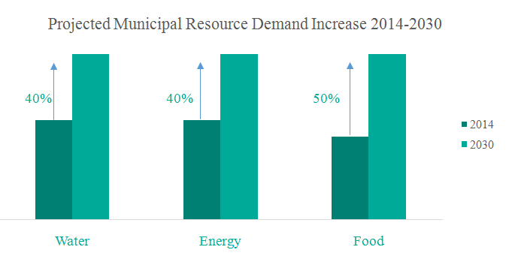
Resource Demand Forecast

Slide 8
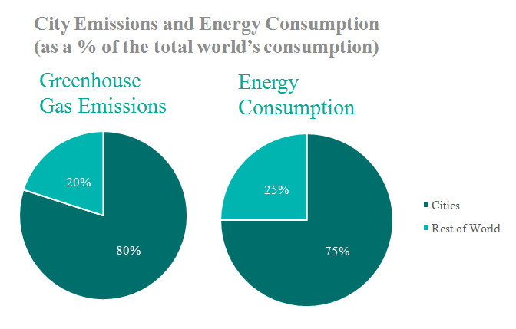
Disproportionate consumption of cities

Slide 9
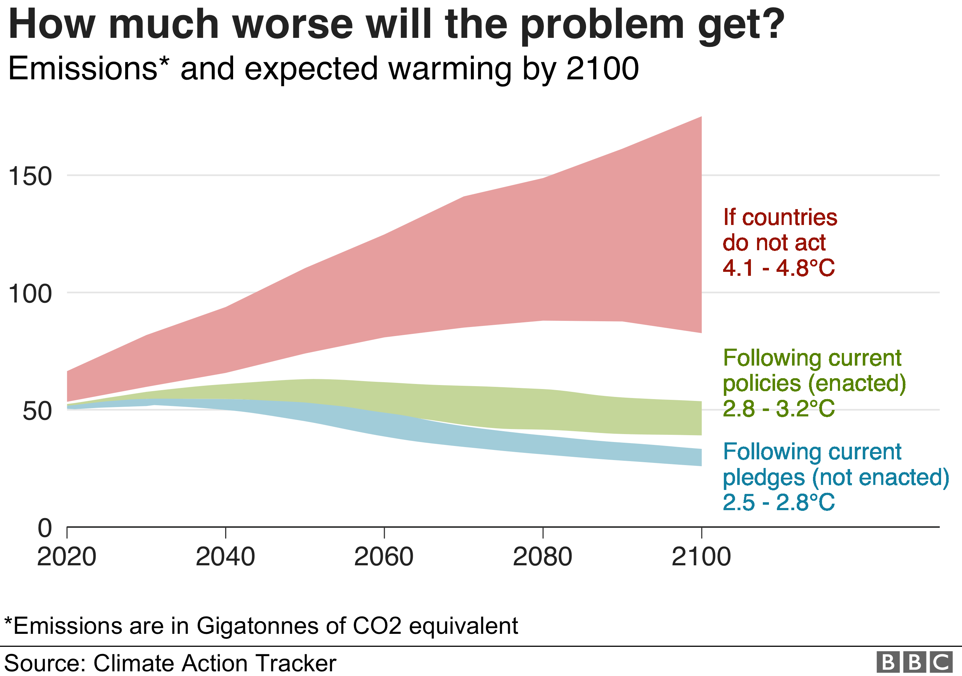

Slide 10
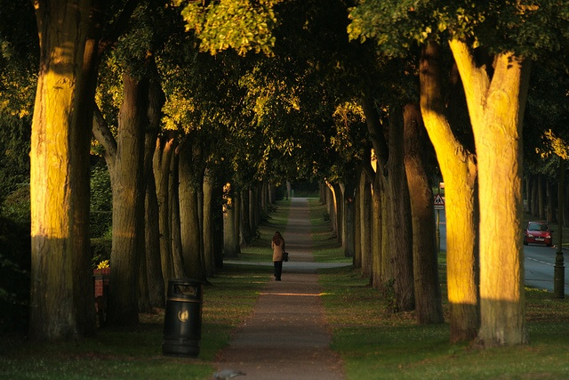
Walking to Work in Letchworth Garden City

Slide 11
RUSH HOUR IN LONDON

Slide 13
NO CITIES or Change?
Loss of architectural heritage
Divide cities into eco-districts
Infrastructure decentralised
Regional Hubs
See Re-invent Paris by Callebaut
Malaysia DiverCity

Slide 14
Newly unveiled plans for Liuzhou Forest City, designed by the Italian firm Stefano Boeri Architetti to be built in southern China, certainly seem to fit the bill. The 342-acre, self-contained neighborhood will comprise more than 70 buildings -- including homes, hospitals, hotels, schools and offices -- all of which will be covered with 40,000 trees and almost a million plants. Eventually, up to 30,000 people could call the Forest City home.

Slide 15
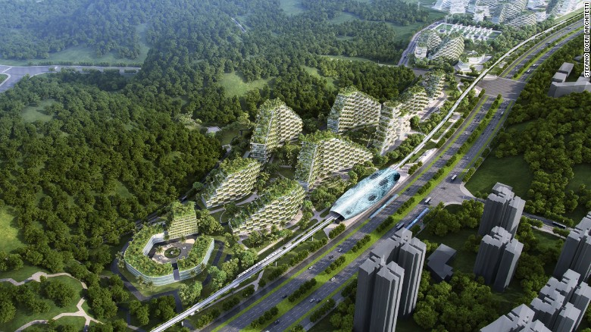
Liuzhou Forest City

Slide 16
Carbon-Absorbing Tree Tower "Tao Zhu Yin Yuan" grows in Taiwan ! The sustainable and Feng Shui tower will carry 23,000 trees planted on the ground and balconies, which can absorb 130 ton CO2 annually in Taipei. Completion 2018 by Vincent Callebaut

Slide 17
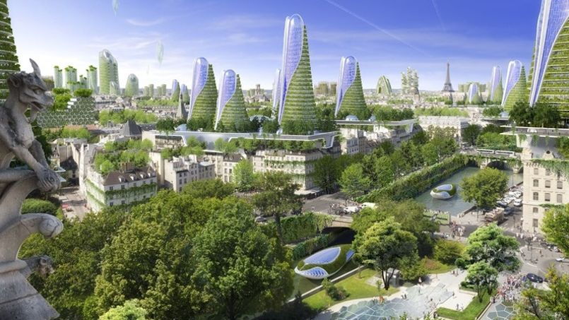
Reinventor Paris Vincent Callebaut
Paris

Slide 18
BIOSTRUCTURES IN PHILIPPINES BY CALLEBAUT

Slide 19
Malaysia BiodiverCity Pending
Bjarke Ingels Group Denmark with Hijjas Architects Planners and Penang Government 2030 Vision
3 Floating Islands with 18,000 residences
Channels(Government and research)/ The Mangroves( business)/ The Laguna( residents)
Laguna has 8 smaller islands
Lots of bamboo/recycled material/waste
Autonomous transport with cycling , walking prorities

Slide 20
Malaysia BioDiverCity

Slide 21
MALAYSIA BioDiverCity

Slide 22
MALAYSIA BioDiverCity

Slide 23
Malaysia BioDiver City

Slide 24
Malaysia BioDiverCity

Slide 25
DECISION -MAKING
Grenfell 2017 and COVID 19 shows we need to rethink how we make decisions
Mulit-dimensional World
Transdiciplinary approach is vital
Costs dominate thinking not Values
Climate Change + Health and Wellbeing vital issues for survival
Can we be a less materialistic world?

Slide 26
Recommendations
Improve connectivity using a neuroscience brain model
Get rid of silo thinking mentality
Use transdiciplinarity approach
Work across sectors to ensure we have the best current thinking in the project.
More about social value
Long term value for money
Technology is an enabler not a master. For example off site construction using 3D/4D printing saves waste, increases precision and diminishes pollution on site so has a social value too.
Our connection with Nature is vital and serves humanity. Biodiversity is part of the infrastructure of towns and cities.
Cities are for people’s wellbeing.
Set up projects to inspire the team and bring in users by for example using augmented reality.

Slide 27
